Slide 1
Greg Hale, Senior Advisor for Energy Efficiency Markets
New York State’s Path to Carbon Neutral Buildings
Climate Change: How Bad Will it Be, and What Must be Done?
Decarbonization Panel
April 22, 2020
Notes:
GH

Slide 2
Agenda
Overview of New York Climate Leadership and Community Protection Act (CLCPA)
Carbon Neutral Buildings Roadmap Process and Intended Outcomes
Building Electrification Roadmap
NYSERDA Programs and Strategies to Decarbonize Buildings
Notes:
GH
The purpose of this session will be to provide an overview of New York State climate legislation and NYSERDA’s Carbon Neutral Buildings Roadmap, and to discuss ways that you can engage in the Roadmap development process, as well as beginning to integrate the State’s energy and climate goals into facilities’ capital planning processes.

Slide 3
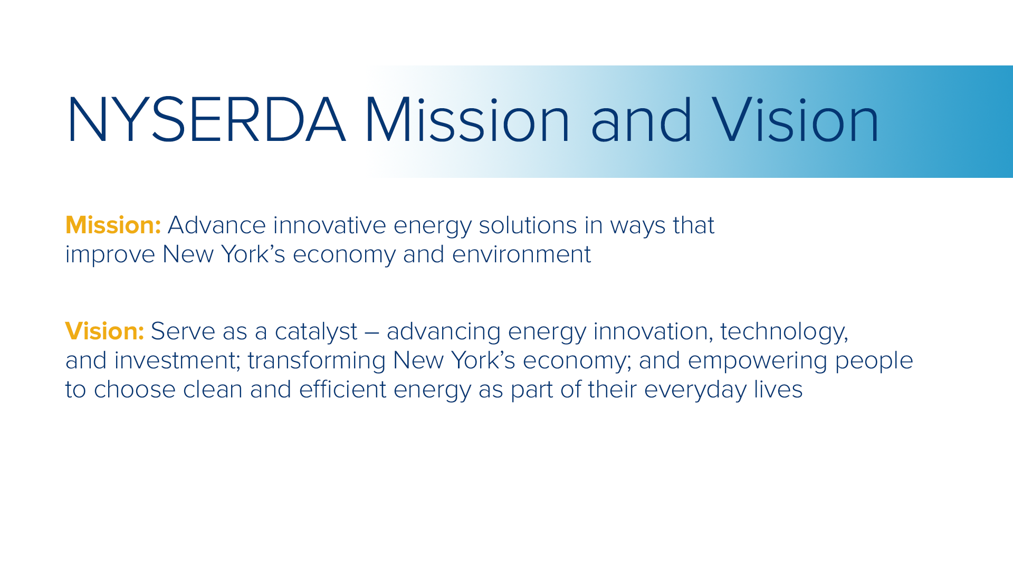
3

Slide 4
"There is no documented historic precedent for the changes needed to prevent even worse disasters from coming."
          IPCC “Global Warming of 1.5°C”
          October, 2018
Notes:
This was before CV
Imagine the power of a similar global (relatively) coordinated response and mitigation effort focused on climate change. Which, unchecked, will wreak far more devastation and exact a much larger human toll than the tragic loss from COVID-19. And such a response would trigger a substantial increase in net economic activity as opposed to dramatic economic retraction that we are experiencing today.
The second precedent is the US wartime economic expansion to meet the needs of WWII. The US remade its entire economy over the course of a few decades after the Depression. Using slide rules and protractors.
So don’t tell me we can’t get it done. We just need the political will. Which is totally absent from DC. In fact, this Administration is hell bent on speeding up GHG emissions. But there is also some good news…

Slide 5
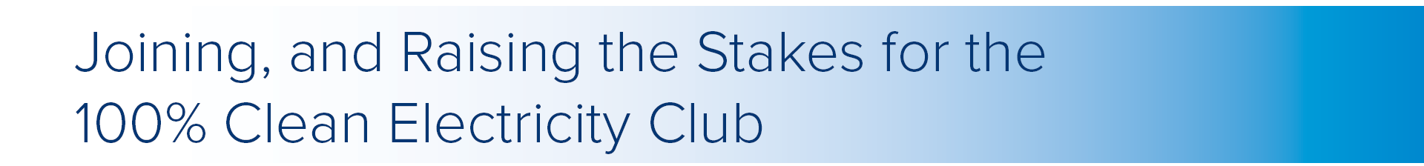
Anticipated, Proposed or Enacted 100% Clean Energy Standards
via Bill or Executive Order MARCH 2019
HI: 2045 (Renewables)
NJ: 2050 (Clean)
CA: 2045 (Clean)
DC: 2032 (Renewables)
KEY
Legislation Anticipated on 100% Clean Electricity to be Introduced in 2019
Non-Binding Goal Introduced
100% CES EO/Ballot Measure has been introduced
Non-Binding Goal Enacted
100% CES EO/Ballot Measure has been enacted
Legislation Introduced on 100% Clean Electricity Standard
Legislation Enacted
on a 100% Clean Electricity Standard
Source: EQ Research Policy VistaTM Legislative Tracking Database
Notes:
Graphic: May 2019
Updates:
Colorado: Legislation enacted, Climate Action Plan, committing the state to a series of GHG emissions reductions, including 50% cut by 2030 and 90% cut by 2050.
Nevada: Nevada SB 538 was passed unanimously by both the Senate and Assembly in 2019, setting the goal of 50% renewable electricity statewide by 2030, & 100% clean energy by 2050.
Maine: In June 2019, Maine adopted a new Renewable Portfolio Standard (LD 1494), committing the state to 80 percent renewable energy by 2030 and 100 percent by 2050
Wisconsin: Gov. Tony Evers signed an Executive Order setting the state on a path to reach 100% carbon free electricity by 2050. The EO created the Office of Sustainability and Clean Energy and is charged with working with other state agencies and utilities to achieve carbon-free energy within the state by 2050
Minnesota: Renewable Goal – 100% renewable energy by 2050
New Jersey: Executive Order 28 – 100% clean energy by 2050

Slide 6
Anticipated, Proposed or Enacted 100% Clean Energy Standards
via Bill or Executive Order MAY 2019
HI: 2045 (Renewables)
NJ: 2050 (Clean)
CA: 2045 (Clean)
DC: 2032 (Renewables)
WA: 2045 (Clean)
NM: 2045-2050 (Clean)
NV: 2050 (Clean)
PR: 2050 (Renewables)
KEY
Legislation Anticipated on 100% Clean Electricity to be Introduced in 2019
Non-Binding Goal Introduced
100% CES EO/Ballot Measure has been introduced
Non-Binding Goal Enacted
100% CES EO/Ballot Measure has been enacted
Legislation Introduced on 100% Clean Electricity Standard
Legislation Enacted
on a 100% Clean Electricity Standard
Source: EQ Research Policy VistaTM Legislative Tracking Database
Notes:
Already engaged with multiple actors working in this sector;
some already fully bought in to this approach
Others need some more work: primarily utilities and some sister agencies
Graphic: May 2019
Updates:
Colorado: Legislation enacted, Climate Action Plan, committing the state to a series of GHG emissions reductions, including 50% cut by 2030 and 90% cut by 2050.
Nevada: Nevada SB 538 was passed unanimously by both the Senate and Assembly in 2019, setting the goal of 50% renewable electricity statewide by 2030, & 100% clean energy by 2050.
Maine: In June 2019, Maine adopted a new Renewable Portfolio Standard (LD 1494), committing the state to 80 percent renewable energy by 2030 and 100 percent by 2050
Wisconsin: Gov. Tony Evers signed an Executive Order setting the state on a path to reach 100% carbon free electricity by 2050. The EO created the Office of Sustainability and Clean Energy and is charged with working with other state agencies and utilities to achieve carbon-free energy within the state by 2050
Minnesota: Renewable Goal – 100% renewable energy by 2050
New Jersey: Executive Order 28 – 100% clean energy by 2050

Slide 7
Anticipated, Proposed or Enacted 100% Clean Energy Standards
via Bill or Executive Order AUGUST 2019
HI: 2045 (Renewables)
CA: 2045 (Clean)
DC: 2032 (Renewables)
NY: 2040 (Clean)
WA: 2045 (Clean)
NM: 2045-2050 (Clean)
NV: 2050 (Clean)
CO: 2050 (Clean)
ME: 2050 (Clean)
PR: 2050 (Renewables)
WI: 2050 (Clean)
NJ: 2050 (Clean)
KEY
Legislation Anticipated on 100% Clean Electricity to be Introduced in 2019
Non-Binding Goal Introduced
100% CES EO/Ballot Measure has been introduced
Non-Binding Goal Enacted
100% CES EO/Ballot Measure has been enacted
Legislation Introduced on 100% Clean Electricity Standard
Legislation Enacted
on a 100% Clean Electricity Standard
Source: EQ Research Policy VistaTM Legislative Tracking Database
Notes:
Already engaged with multiple actors working in this sector;
some already fully bought in to this approach
Others need some more work: primarily utilities and some sister agencies
Graphic: May 2019
Updates:
Colorado: Legislation enacted, Climate Action Plan, committing the state to a series of GHG emissions reductions, including 50% cut by 2030 and 90% cut by 2050.
Nevada: Nevada SB 538 was passed unanimously by both the Senate and Assembly in 2019, setting the goal of 50% renewable electricity statewide by 2030, & 100% clean energy by 2050.
Maine: In June 2019, Maine adopted a new Renewable Portfolio Standard (LD 1494), committing the state to 80 percent renewable energy by 2030 and 100 percent by 2050
Wisconsin: Gov. Tony Evers signed an Executive Order setting the state on a path to reach 100% carbon free electricity by 2050. The EO created the Office of Sustainability and Clean Energy and is charged with working with other state agencies and utilities to achieve carbon-free energy within the state by 2050
Minnesota: Renewable Goal – 100% renewable energy by 2050
New Jersey: Executive Order 28 – 100% clean energy by 2050

Slide 8
Anticipated, Proposed or Enacted 100% Clean Energy Standards
via Bill or Executive Order APRIL 2020
HI: 2045 (Renewables)
CA: 2045 (Clean)
DC: 2032 (Renewables)
NY: 2040 (Clean)
WA: 2045 (Clean)
NM: 2045-2050 (Clean)
NV: 2050 (Clean)
CO: 2050 (Clean)
ME: 2050 (Clean)
PR: 2050 (Renewables)
WI: 2050 (Clean)
NJ: 2035 (Renewables)
CT: 2050 (Clean)
RI: 2030 (Renewables)
VA: 2036 (Clean)
NY: 2040 (Clean)
KEY
Legislation Anticipated on 100% Clean Electricity to be Introduced in 2019
Climate Leadership and
Community Protection Act (CLCPA)
Non-Binding Goal Introduced
100% CES EO/Ballot Measure has been introduced
Non-Binding Goal Enacted
100% CES EO/Ballot Measure has been enacted
Legislation Introduced on 100% Clean Electricity Standard
Legislation Enacted
on a 100% Clean Electricity Standard
Source: EQ Research Policy VistaTM Legislative Tracking Database
Notes:
4.7.20:
Vermont and Mass likely to enact legislation soon.
Even states without the 100% goals have cities who are stepping up and making 100% commitments.

Slide 9
Overview of New York Climate Leadership and Community Protection Act (CLCPA)

Slide 10
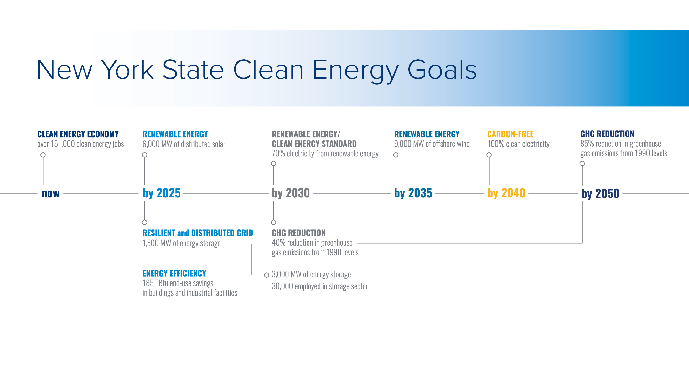
Climate Leadership and Community Protection Act (CLCPA)
35% - 40% of the benefits of state CLCPA investments
must flow to disadvantaged communities
Notes:
Presenter: GH
Explain how the Roadmap fits into the CLCPA

Slide 11
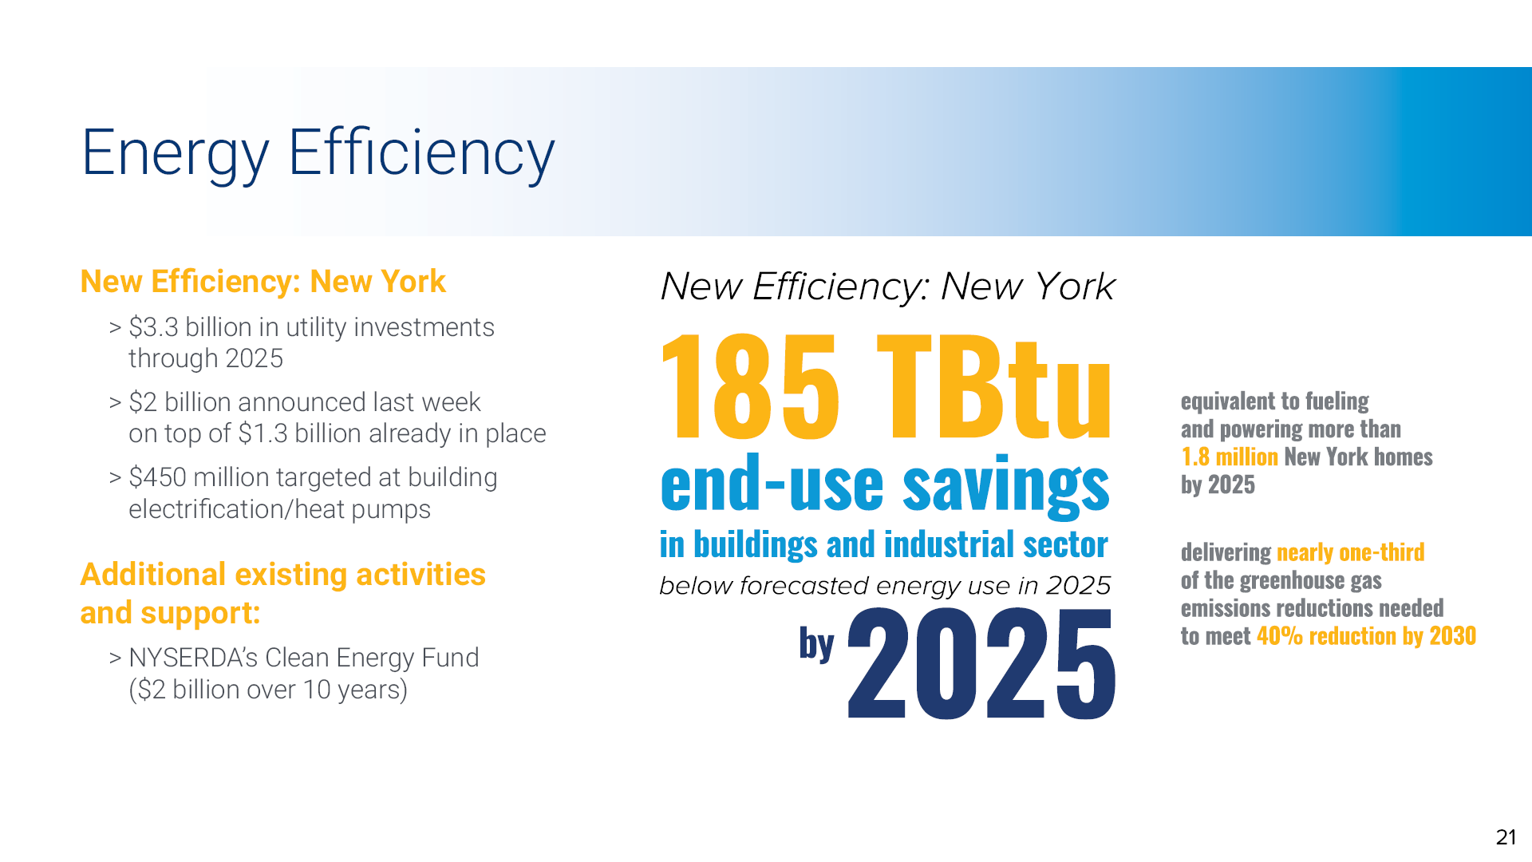

Slide 12
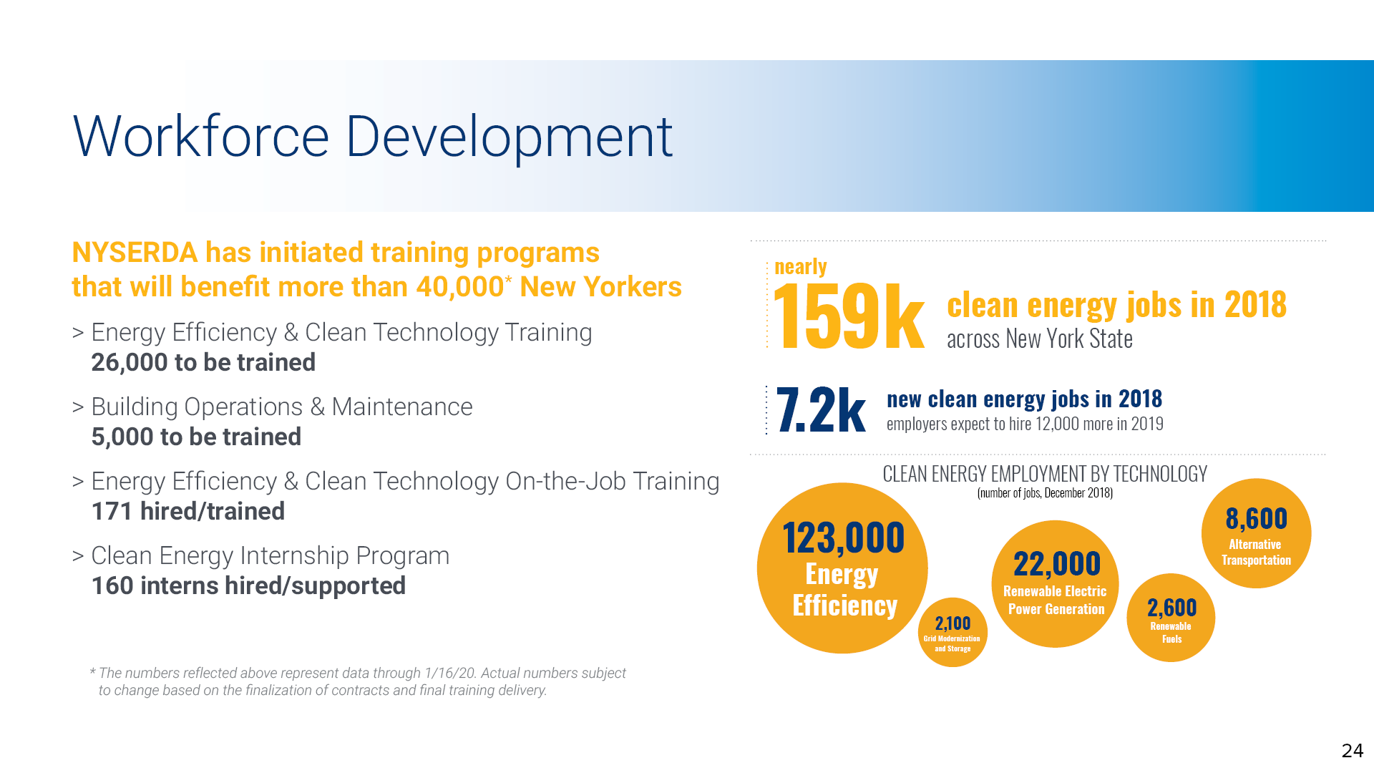
Notes:
Estimated 2019 job growth ~12,000
Could lose an equal amount of jobs in 2020; over 4,000 CE jobs lost in 1st Q in NYS
Quick mention of state efforts to change various program eligibility requirements, remote work practices, milestone payments, other actions to support our clean energy industry partners…

Slide 13
The Carbon Neutral Buildings Roadmap: Process and Intended Outcomes

Slide 14
Greenhouse Gas Emissions Reduction Target
85
by
50
New York’s 85x50 emissions reduction target will require a carbon neutral statewide building stock
Notes:
WHAT WE NEED TO ACHIEVE
NZC means electrifying all building mechanical systems, then ensuring that all of the electricity consumed is produced from non-emitting (i.e., renewable) resources.

Slide 15
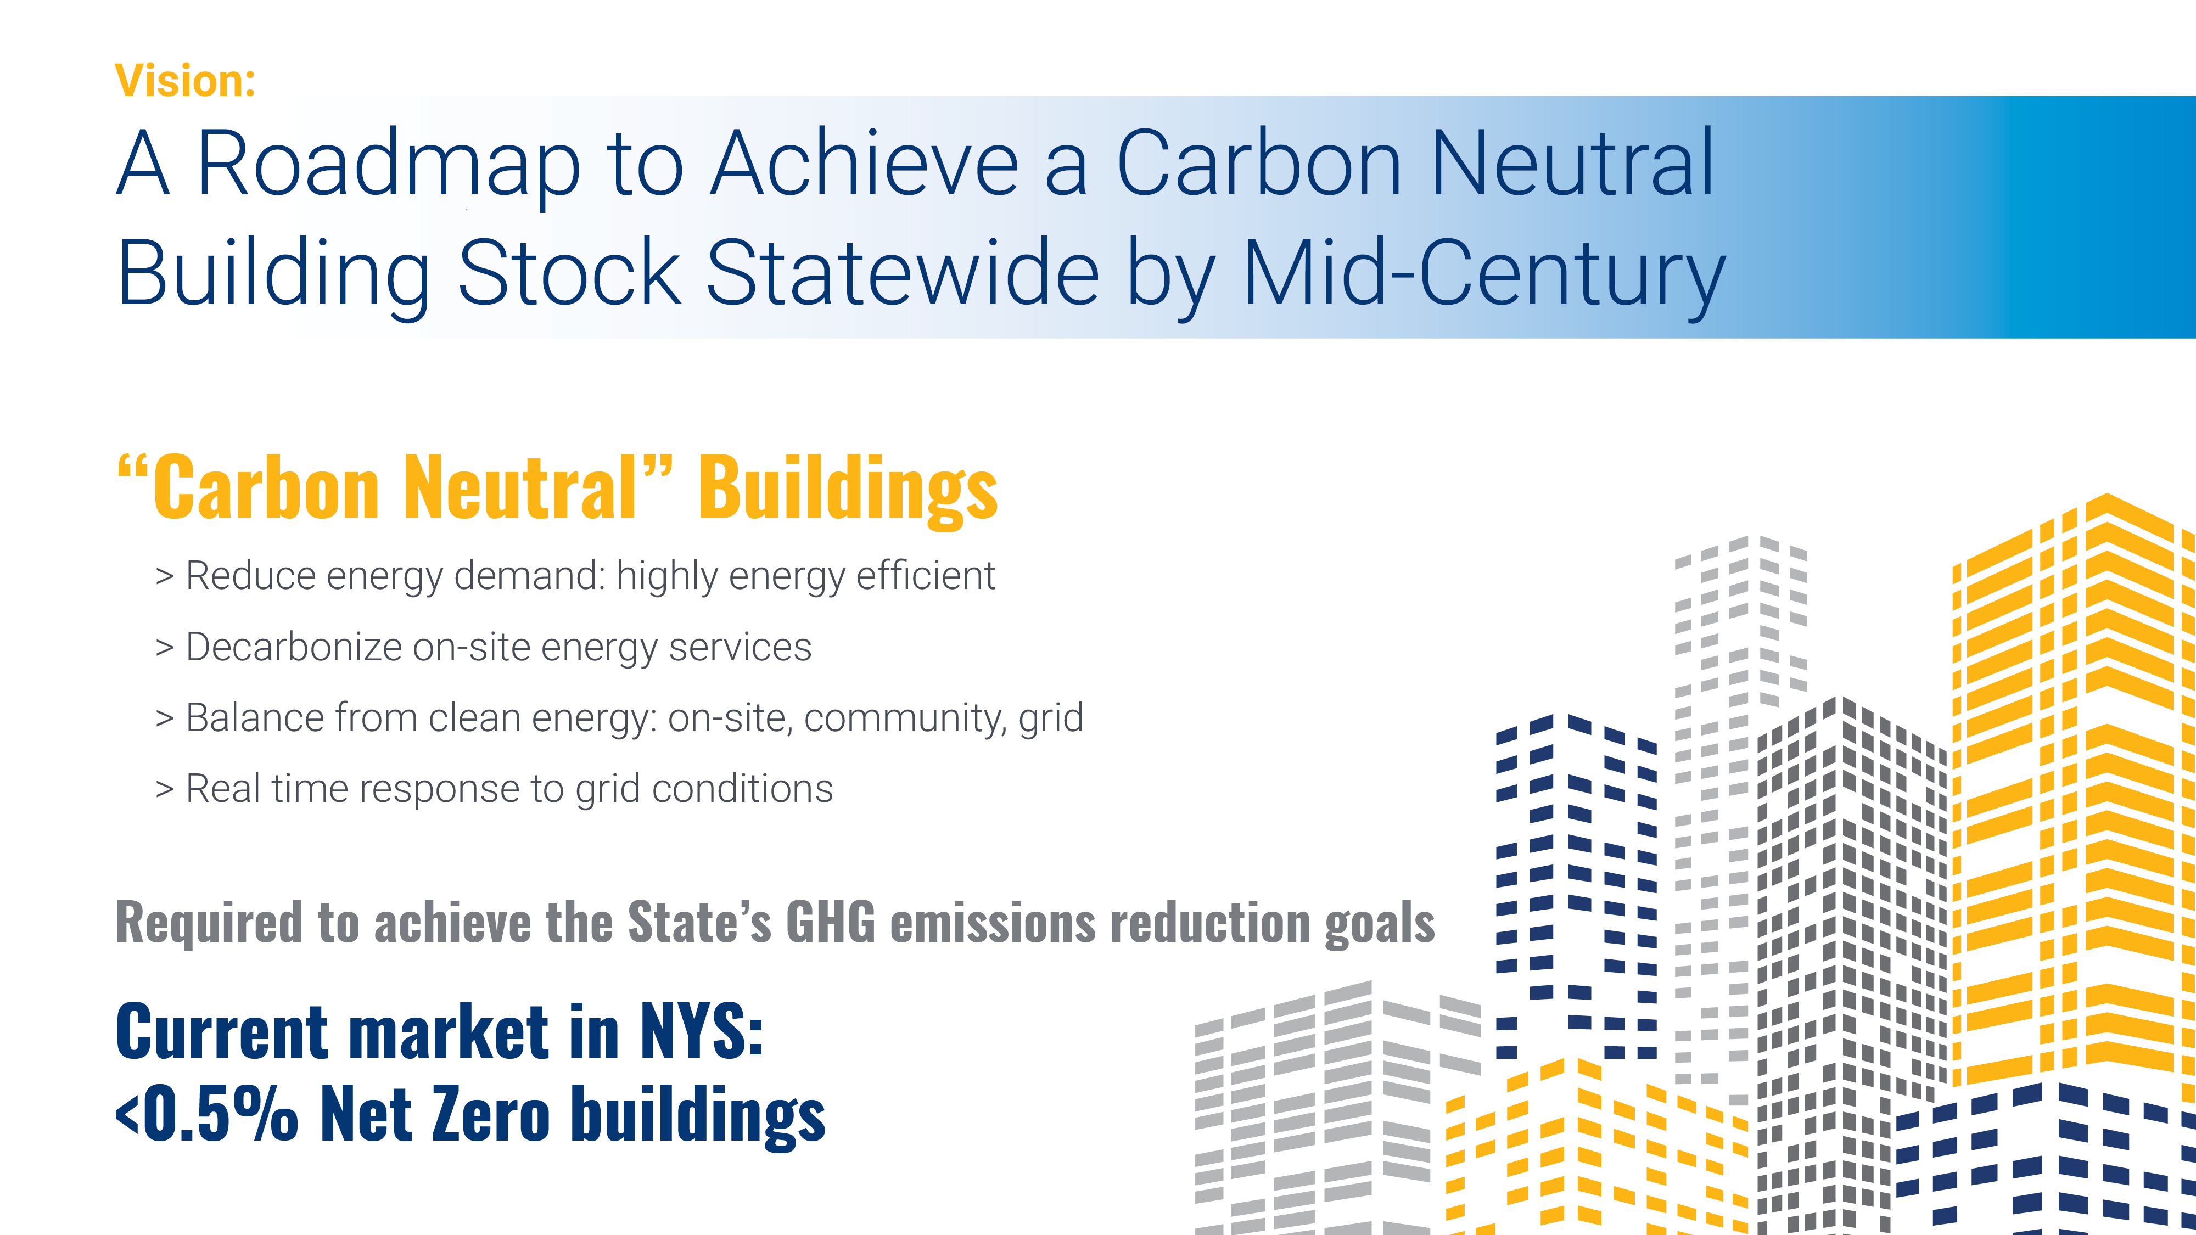
Notes:
This all means big changes in the building stock of New York – but how do we get there? That’s why NYSERDA is working on a Roadmap that will feed into the CLCPA process and the City’s own regulatory process. Published Q4 2020, draft this spring.
The Roadmap will tackle things like: What do we even mean by a carbon neutral building? Well, here’s one way to define it that I think is pretty good:
- Reduce energy demand in base building (envelope performance)
- Highly efficient MEP systems & appliances
- Generate or procure renewable electricity (onsite/community/grid) & reduce or eliminate fossil fuel systems onsite
- Responsive to grid conditions
Smart spec’ing of materials & refrigerants
Clearest path: Full electrification of the building energy system.

Slide 16

Carbon Neutral Buildings Roadmap
Explore pathways necessary to achieve a carbon neutral building stock
Research critical building decarbonization issues
Engage stakeholders
Send long-term market signal & mobilize different sectors
Raise awareness of the benefits of carbon neutrality
  Energy savings
  Health, comfort, and productivity
  Resilience
Provide guidance for other state agencies and local governments
Living document
Notes:
End Goal: achieve deep energy efficiency in buildings, with flexible and grid-responsive loads supplied by renewable electricity.
Take immediate action to transform business as usual approaches;
Decarbonize buildings, reduce and shift loads, and expand DERs, while cleaning the grid;
Base recommendations on current best practices and market insights, while also aiming to shape their evolution;
Decarbonization pathway= Flexibility is critical: allow for varying intensity of building energy use;
Cost-effectiveness is a top priority;
Advance existing regulatory measures and explore new options;
Account for non-energy benefits;
Avoid false precision in quantitative analyses; and
Rely on stakeholder feedback.

Slide 17
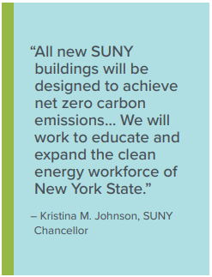
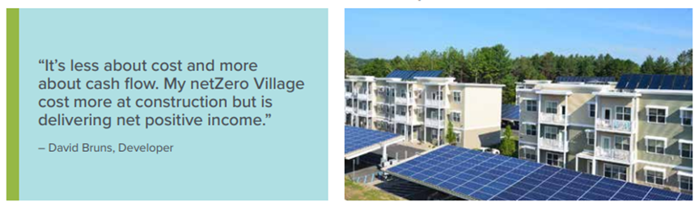
Roadmap Scope
New Construction
Design and deliver economic, emission-free buildings
Driving Energy Codes to Zero
Existing Buildings
Comprehensive vs. Phased Capital Plan
Multiple Sectors
Single-Family, Multifamily, Office, Higher Education
Additional sectors in future Roadmap updates
Notes:
For the purposes of NYSERDA's Buildings Roadmap, Higher Education buildings include only lecture halls, residence halls, and central plants. Central Plants are buildings that contain large-scale energy systems that generate and distribute a thermal medium to service nearby buildings.

Slide 18
Components of the Roadmap
Definitions
& Metrics
New York’s Building Stock Today
Business Case /
Value Proposition
Technology Landscape
Building Electrification
Limits to Electrification Secondary Paths
Priority Sector Pathways
Policy and Regulatory Options
Resilience Implications
What’s Next? Future Research Needs
Notes:
Presenter: GH

Slide 19

Milestone Schedule – Revised March 2020
9/18/19
Stakeholder Events
2019 2020 2021
Oct
Nov
Dec
Jan
Feb
Mar
Apr
May
Jun
Jul
Aug
Sept
Oct
Nov
Dec
Jan
Feb
Mar
1st
Draft
Edit
&
Compile
Final
Draft
Internal
Reviews/
Final
Revisions
PUBLISH
Phase 1:
Research & Writing
Phase 2
9/12
Stakeholder
Kickoff
Public Comment
on Draft Roadmap
#1
Socialize
RM
webinar
9/12
#2
Standards
Definitions
10/7
#3
Priority
Techs
10/24
#4 - #5
Paths &
Value Prop
11/20 –
11/21
#6
Elec. Grid
Issues
12/16
#7
SF Resi.
Techs
1/14
#8
Central
Plants
1/17
#9
Renewable
Fuels
2/24
#10
Refrigerant
GWP
2/27
#11
Real Estate
Actors
3/26
#13
Workforce
& Labor
5/20
#12
Embodied
Carbon
6/02
Phase II: Public Comment on Draft Roadmap
Notes:
Presenter: Greg Hale

Slide 20
Building Electrification is Critical to Advancing
New York’s Goals of a Carbon-Neutral Economy
GHG emission reductions, and deep decarbonization over time: Building electrification in combination with efficiency and 100% clean electric supply is a critical path to carbon neutral buildings
Meaningful overall energy savings
Summer electric peak reductions and potential reduction in delivery rates
Viable alternative to address customer heating needs in natural gas supply-constrained areas
Healthier homes and communities

Slide 21
10-year Roadmap outlining market-development milestones and public policy and investment options that will advance building electrification in New York State
Transforming the way New York heats and cools its buildings
Key Building Electrification Roadmap outputs:
“State of the market” vision for 2030, by market segment and building typology
2030 building electrification goal for NYS
Assessment of the current market
Recommendations for public policies and programs
Engaged constituency for market advancement
Identification of high potential partnering opportunities with other jurisdictions & organizations
Resources available online

Slide 22
NYSERDA Existing Programs to Decarbonize Buildings

Slide 23
NYSERDA Programs Supporting Decarbonization
RetrofitNY
Buildings of Excellence
Codes to Zero
Lead by Example
Net Zero Energy for
Economic Development
Net Zero
Manufactured Housing
Net Zero in New Construction: All Sectors & Portfolio Support
Carbon Neutral Communities

Slide 24
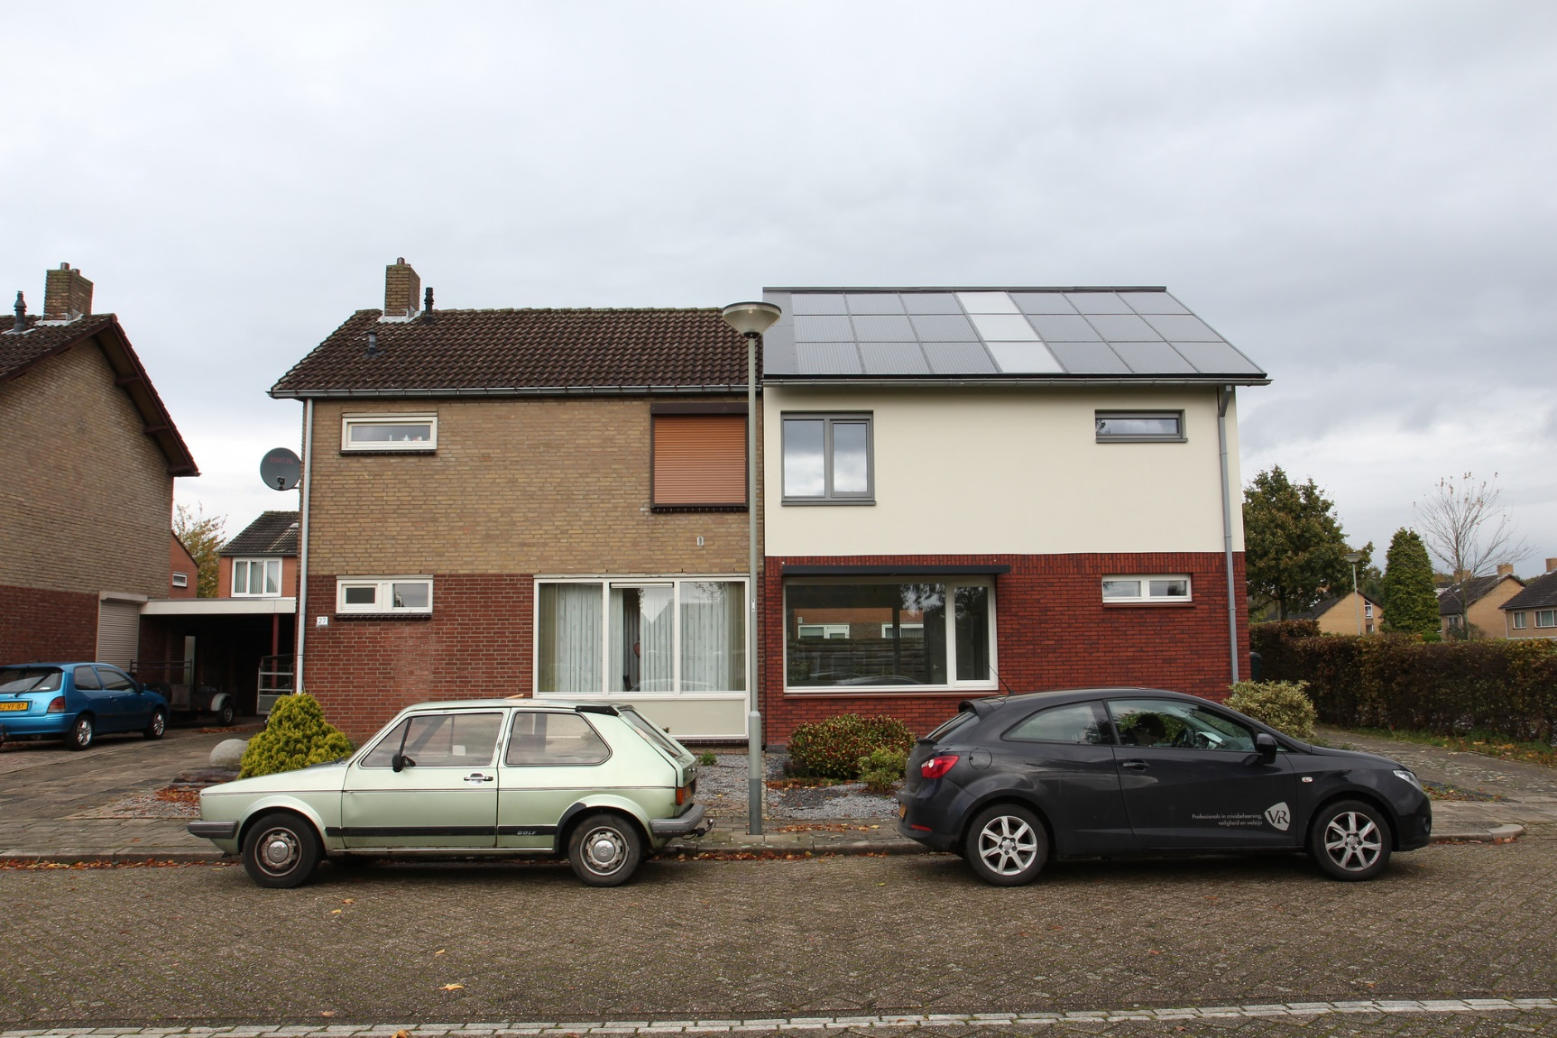
Adapting the Successful Energiesprong Model to New York State
7,500 rehabs
7,500 new construction
20,000 in pipeline

Slide 25

Key Components of Net Zero Retrofit Solution
Elements
Highly insulated building envelope
New, downsized all-electric mechanical works
[On-site] distributed generation
Grid interactivity
Notes:
These are the components; Dutch experience demonstrates that they work equally well for retrofits as for new construction.
Hence the need for single NY program brand to send the demand signal to the market

Slide 26
REV principle: engage private sector capital
Cost reduction
Carbon Neutral Building Retrofits
at
business-as-usual rehab cost
Notes:
MAJOR BARRIER: UP-FRONT COST OF BUILDING OR RETROFITTING TO NET ZERO (there are a number of other barriers to deep retrofits that we are all aware of, but initial cost is the biggest hurdle).
NYSERDA transition from incentive-based → market transformation
Where is intervention of public $$ likely to unlock a market?
Desired outcome: cost compression such that NZE construction/retrofit can be undertaken w/o material incremental upfront cost over BAU.
And we have a near term strategy for this (i.e., a critical NYSERDA development activity for the 2019-2021 time frame): prefabricated high performance component manufacturing. Plug and Play.

Slide 27
Adapting the Successful Energiesprong Model to New York State
7,500 rehabs
7,500 new construction
20,000 in pipeline

Slide 28
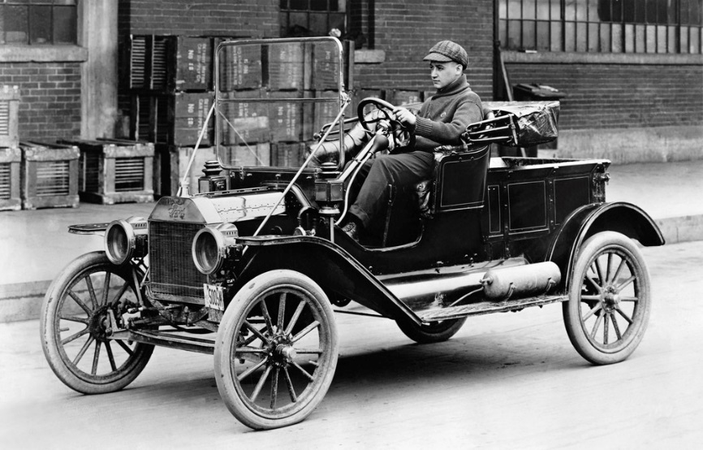
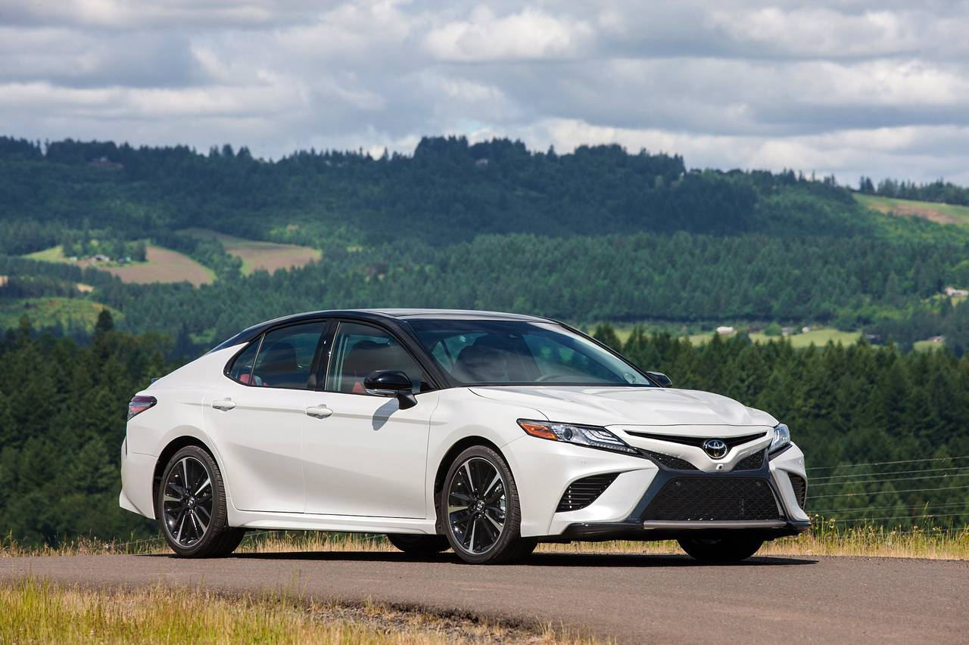
Then vs Now
Notes:
In other words, how do we get from a Ford model T to a Toyota Carmry

Slide 29
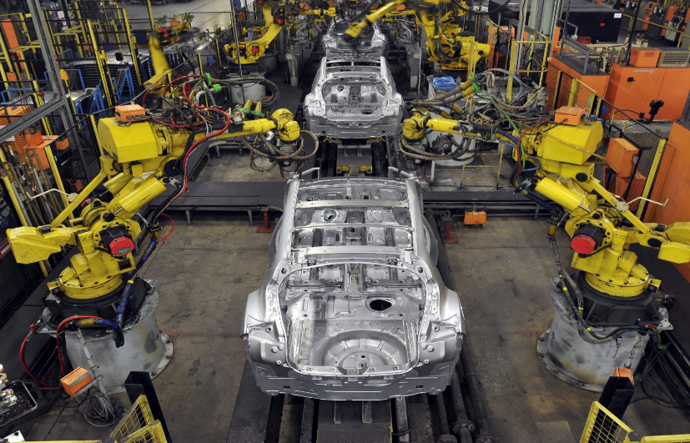
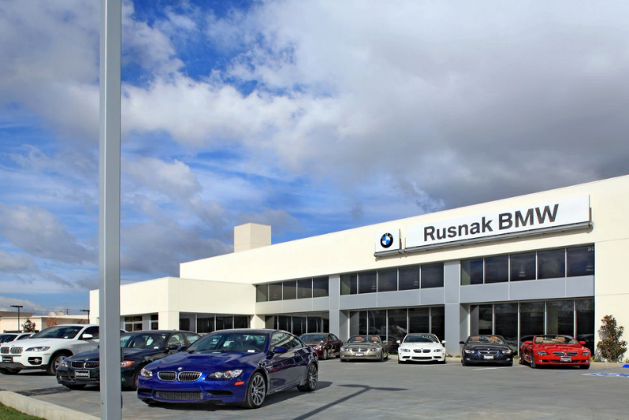
SUPPLIER
SUPPLIER
>
SUPPLIER
>
>
>
>
>
>
>
MARKETING
SALES MAINTENANCE
CUSTOMER

Slide 30


Slide 31
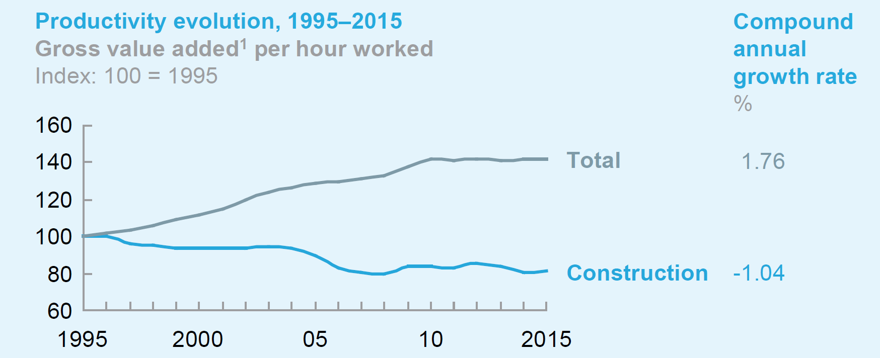
Source: McKinsey Global Institute, Reinventing Construction: a Route to Higher Productivity, 2017

Slide 32
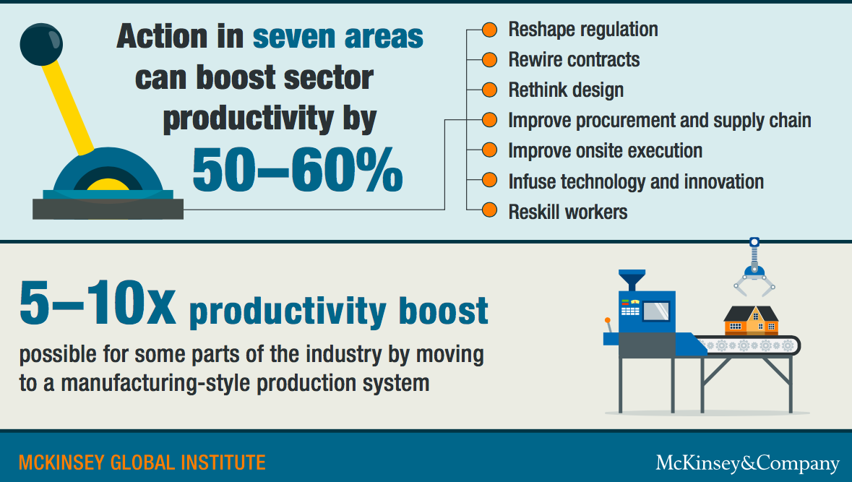

Slide 33
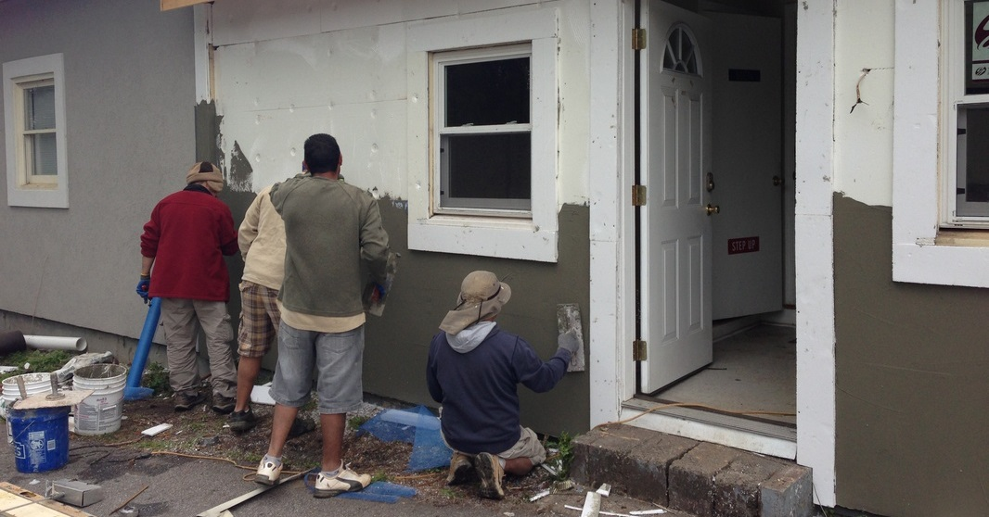

Conventional Process

Slide 34
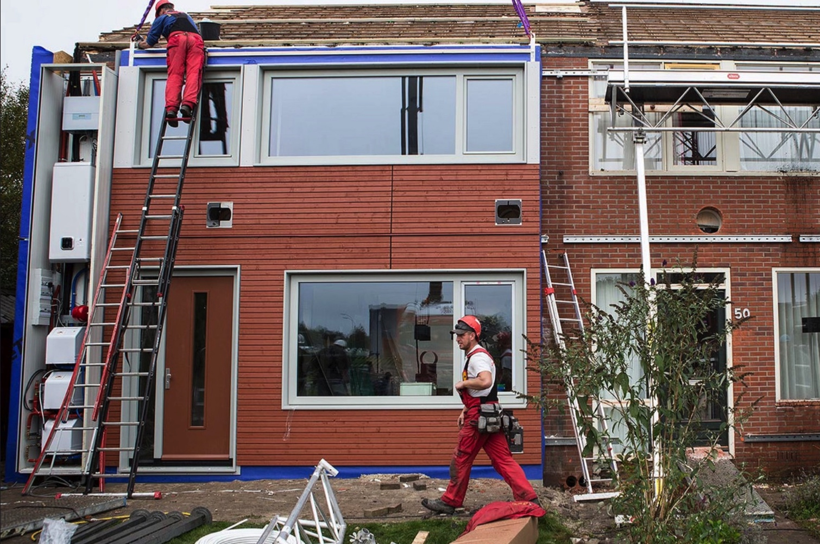
Prefabricated High Performance Components
Conventional Process
Prefabricated High Performance
Components

Slide 35
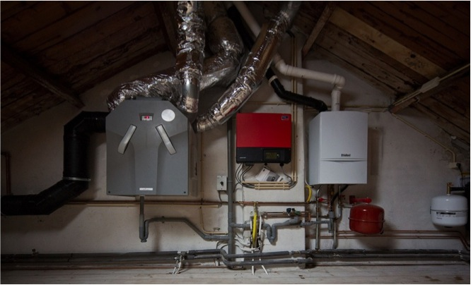
Conventional Configuration
Notes:
Marketing: can you make the picture cover the whole slide, and add NYSERDA logo in white?

Slide 36
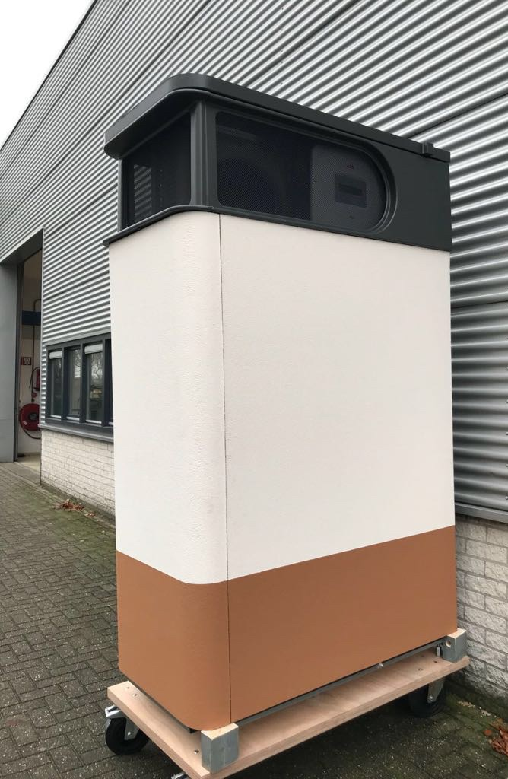
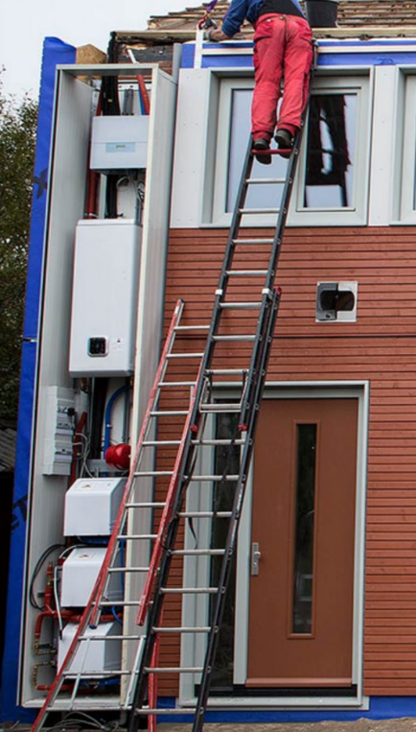
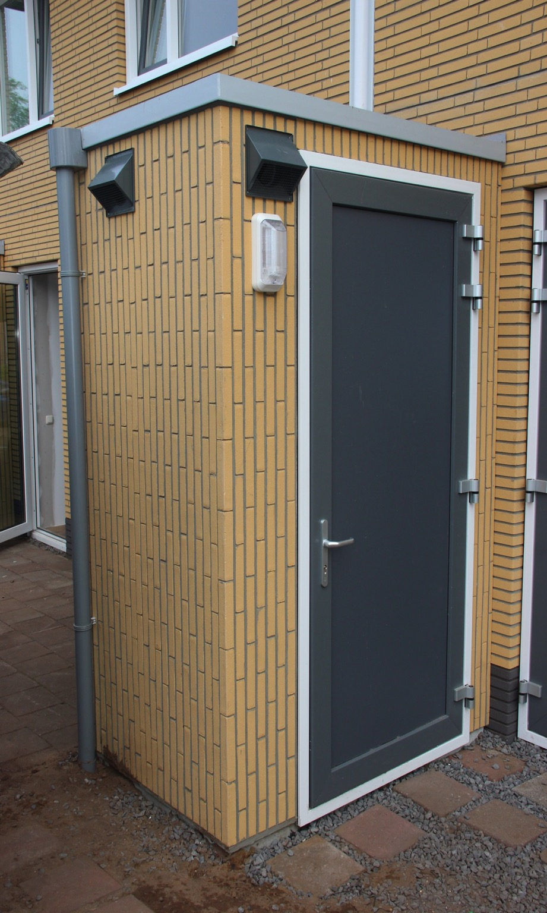
Integrated Mechanical Systems
Notes:
Integrated Mechanical Systems

Slide 37
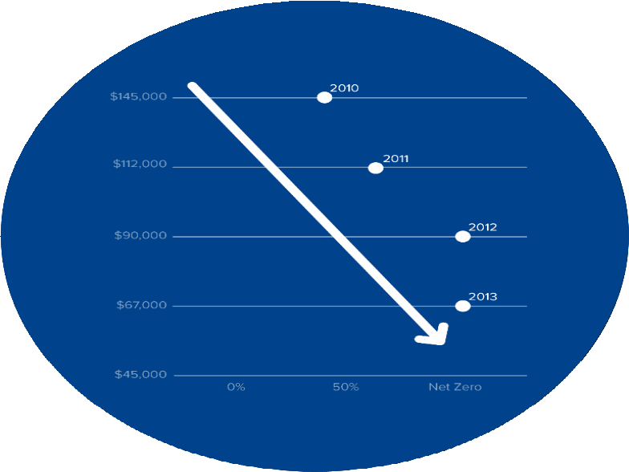
Key Achievements of the Energiesprong Program
Net Zero Energy Buildings at 40% of the Cost of Initial Pilots

Slide 38
Strategic
Partners:
NYSERDA Market Dev and Innovation Programs
Brussels
California
Vancouver
NYC
DOE
AIA
ASHRAE
USGBC
SUNY
NYPA
HCR ESD
DPS
DOS
NREL
LBNL
OAK RIDGE
Demonstrating
Demand to the
Manufacturing
Sector
PHI
PHIUS
NYPH
NBI
RMI
NEEP
BDC
Utilities
Notes:
Already engaged with multiple actors working in this sector;
some already fully bought in to this approach
Others need some more work: primarily utilities and some sister agencies

Slide 39
NYStretch Energy Code 2020
Readily adoptable local energy code that is more efficient than NYS’s base energy code.
A pivotal tool in supporting energy/climate goals.
Calls for higher energy efficiency standards for new and renovated construction projects.
NYC recently updated its energy code to align with the NYStretch Code, effective May 12,2020
Roughly 11% more efficient than 2020 ECCCNYS.
Notes:
The City’s Energy Code must have the same effective date as the State’s Energy Code, which will be May 12, 2020.

Slide 40
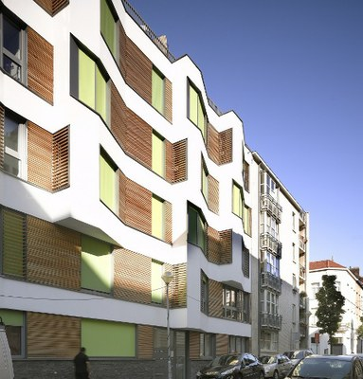
Buildings of Excellence
Design competition for Multifamily Buildings
$1M max project award
Net Zero Energy / Low-Carbon
Layers on top of Standard Offer Program Incentives
Applicants: Developers / Building Owners & Designers
Round 2 submissions due 5/27/20
034 Midi-Suede, photo credit Environment Brussels
Notes:
Adapted from Program run in Brussels that totally changed the high performance building market in that city.

Slide 41
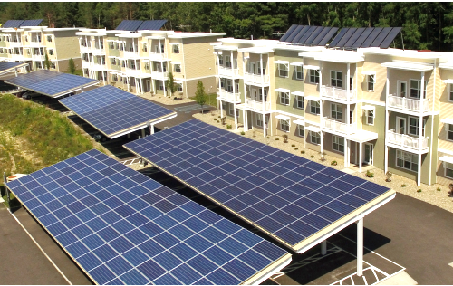
Buildings of Excellence – What Kind of Projects?
Electrification
Deep Efficiency
Onsite generation / procure renewables
Storage & smart systems
Notes:
Round one winners were announced in late October 2019. The winning projects focused on building electrification; net zero energy and use of renewables. The portfolio of winners exemplifies the competition’s mission to bring low to zero carbon buildings to scale in New York State. Tonight we are going to showcase three winning projects located in the NYC metro area that were designed by Magnusson Architecture and Planning.
Magnusson works with nonprofit organizations, municipalities, and for-profit developers to improve the lives of those who live and work in their communities. For over three decades, their award-wining housing and neighborhood revitalization projects have been at the forefront of quality design and sustainability within the industry.
Magnusson specializes in affordable, supportive, senior and workforce housing, as well as buildings with a range of affordability including market-rate or integrated supportive units. Their expertise extends to community-based planning and urban design, resident-in-place renovations, and sustainable development aimed at the highest levels of LEED, Passive House certifications and even net zero energy use.

Slide 42
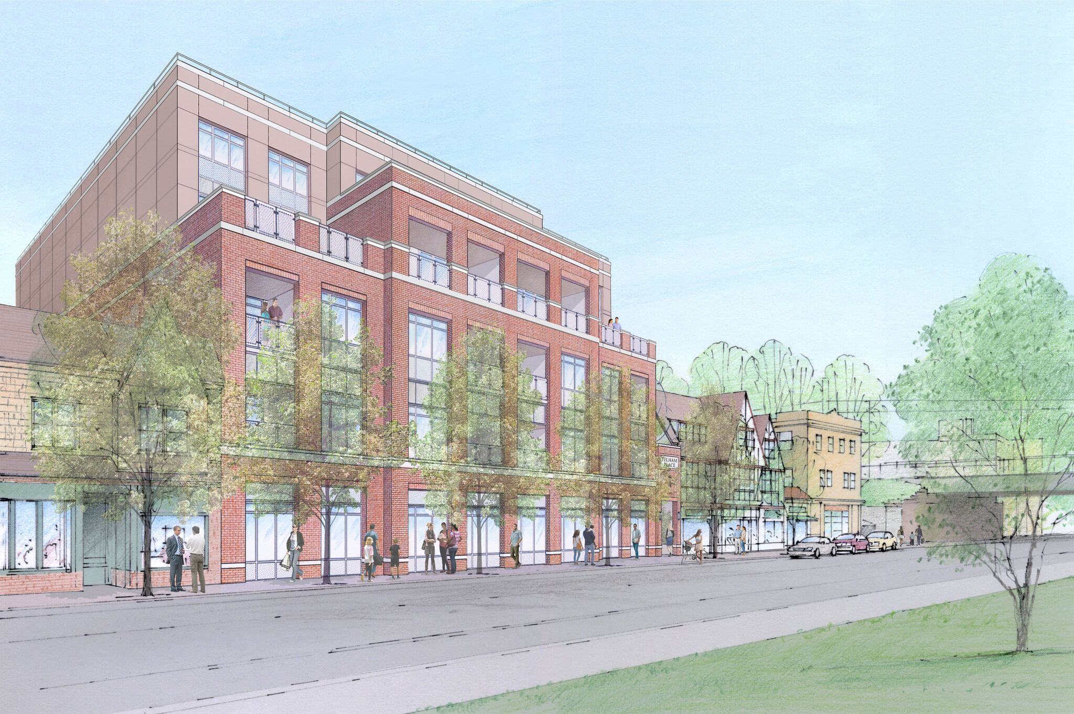
Mixed-use New Construction
101 Wolf’s Lane – Matriarch
Net Zero Energy for Economic Development Program
Incentive: $1,092,000
Project
120,000 Square Feet
58 units/ 5% LMI
Transit Oriented & Infill Development
Residential & 1st Floor Commercial
NZE Scope of Work
Modular Construction
VRFs
Roof-top solar
101 Wolf’s Lane – Pelham, NY
Developer – Matriarch
Notes:
This project is currently in design development.
The incentive for this project is for all the energy efficiency and energy generation measures in the scope of the project.
101 Wolf's Lane is a smart growth transit-oriented development, mixed-use building containing
7,370 square feet of commercial/retail space,
a parking garage and
58 residential units (5% affordable).
This new construction building will utilize
energy efficient modular design and construction features, as well as
install solar energy systems on the roof and the façade to achieve net zero energy performance.
The project is located in a community that has applied to their Regional Economic Development Council for the Downtown Revitalization Initiative program.

Slide 43
Net Zero Planning and Design - Urban
New York University
Project
Greenwich Village, contiguous properties of NYU
44 Buildings on Central Plant District System
6.9 Million Square Feet
Residential, dormitory, office, academic, laboratory, performance & library
NZE Master Plan
Net Zero Carbon Emissions
Building-Level Analysis
Loop Infrastructure Analysis
Central Plant Study
Renewable Energy Optimization & Procurement
Study High-Intensity Process Loads

Slide 44
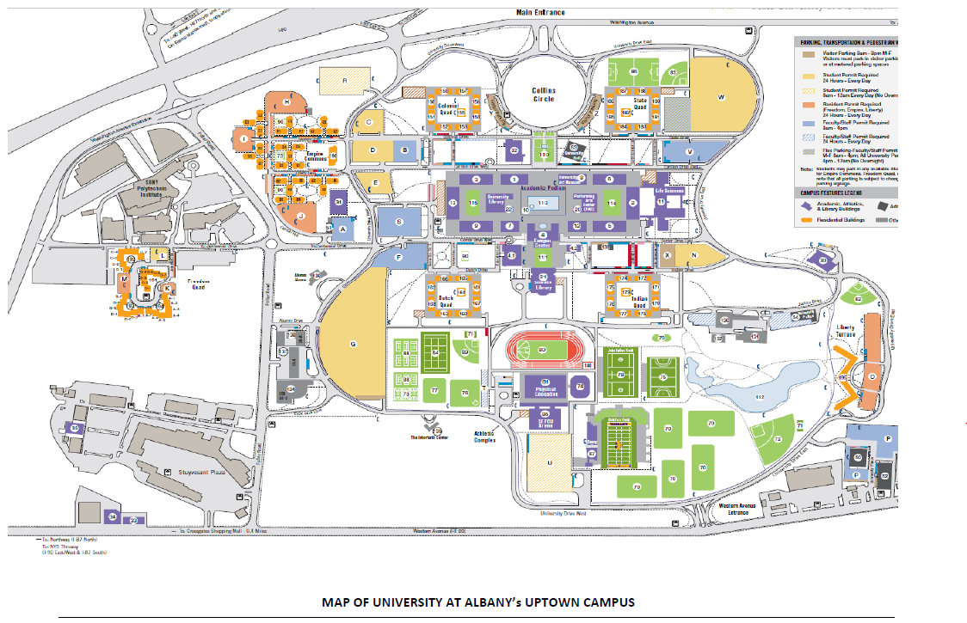
Net Zero Planning and Design - Suburban
University at Albany- Uptown
Project
4.7 Million Square Feet
450 Acres
Residential, dormitories, office, academic, research/laboratories, libraries, athletic, & services
NZE Master Plan
Net Zero Energy/Carbon Campus
Building-level load reduction strategies
District System improvements
Human Impacts
Renewable Energy Installations
Implementation Plan

Slide 45
Thank you
Please send additional questions, comments, and concerns to the
Carbon Neutral Buildings team at:
CarbonNeutralBuildings@nyserda.ny.gov

Slide 46
APPENDIX
Additional NYSERDA High Performance Buildings Programs

Slide 47
Competitive Awards for New Construction
Comprehensive New Construction, Gut Rehabilitation, and Business Expansion Projects to Achieve Net Zero and Ultra Low Carbon Performance
Commercial, Industrial, and Mixed-Use Buildings
Net Zero for Economic Development (with extra points in gas constrained areas):
Delivered in the CFA
  $15 million in funding, additional bonus funding available
  One-stop program for Commercial, Industrial, and Mixed-Use Buildings to Achieve Net Zero Energy
  Provides master planning and design for campuses and communities to achieve Net Zero and Carbon Neutral
  Additional Rounds Planned for 2020 and 2021
Multifamily and Mixed-Use Buildings
Buildings of Excellence: Round 2 Available
  $40 million in funding available
  Awards in addition to other funding
  Round 2 for $10 million currently open

Slide 48
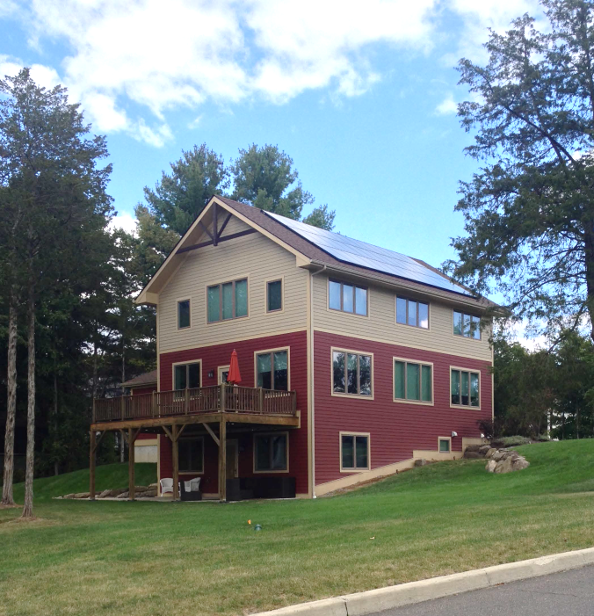
Single-Family Homes New Construction
Greenhill Contracting
Low-rise Residential New Construction Program
Incentive: $8,000
Project
Single-family home
Neighborhood NZE Development
LEED for Homes
DOE Zero Energy Ready
NZE Scope of Work
Ground Sourced Heat Pump shared well with water
Insulated Concrete Form
HRV
Roof-mounted solar
ENERGY STAR® Appliances
LED Lighting
Net Zero Energy Home – New Paltz, NY
Builder – Greenhill Contracting
Notes:
This project is complete.
As with the previous slide, the incentives for this project were based on a program offering that was available at the time this project applied to the program. To see the current Low-rise Residential New Construction program incentive levels, please visit our website. This project was also eligible to receive incentives from NYSERDA’s NY Sun incentive program for the solar electric system.
Greenhill contracting has a unique approach to building net zero energy homes. They build multiple homes at a time to access economies of scale.
By using ICF construction, these homes are not only energy efficient, they are also resilient maintaining livable internal temperatures for days, and are hurricane, tornado and earthquake resistant.
These homes are all electric, and with the roof-mounted PV, are net zero energy performance.

Slide 49
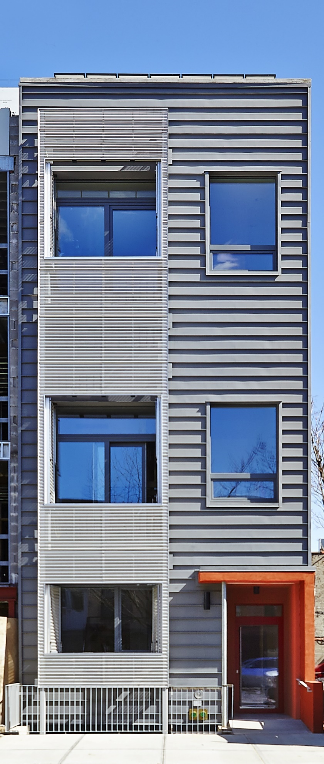
Low-rise Residential New Construction
R951
Low-rise Residential New Construction Program Incentive: $24,000
Project
3-Unit Apartment Building
Brooklyn, NY
Passive House Institute US -Certified
DOE Zero Energy Ready
NZE Scope of Work
Ductless Minisplit ASHPs
Insulated Concrete Form
ERV
Roof-mounted Solar
ENERGY STAR® Appliances
LED Lighting
R951– Brooklyn, NY
Builder – Further, Inc.
Notes:
This project is complete.
The incentives for this project were based on a program offering that was available at the time this project applied to the program. To see the current Low-rise Residential New Construction program incentive levels, please visit our website. This project also qualified for incentives from NYSERDA’s NY Sun program for the solar equipment.
The building uses no fossil fuels, which eliminated the need to install gas lines, boiler flues and related piping.
This allowed the project to offset additional costs associated with the superior envelope as required by PHIUS standards.
The ductless mini-split air source heat pump systems provides occupant controlled heating and cooling as necessary.
Additionally, the walls ‘shared’ with condominiums in adjoining buildings provided savings on insulation compared to the exposed walls.

Slide 50
Commercial New Construction
Technical and Financial Support for Zero Net Energy, Deep Energy Savings Projects, and/or Smart Buildings
Technical Support -100% of the technical consultant’s costs up to a maximum $200,000 per project. Includes assessment of electrification options.
Financial Support
  Energy Performance Incentive for Zero Net Energy, Deep Energy Savings, and/or Smart Buildings:
  $150/Ton CO2 saved, up to a maximum $350,000 per project ($450,000 for All-Electric Projects or projects in gas constrained areas)
    Design Incentive (for All-Electric Projects in any location and projects in gas constrained areas) 5% of the energy performance incentive. The minimum design incentive is $5,000 and the maximum is $50,000.
  Smart Buildings:
  50% of the increased costs of installing smart meters, equipment, and controls to achieve a fully integrated smart building, up to a maximum $100,000 per project.

Slide 51
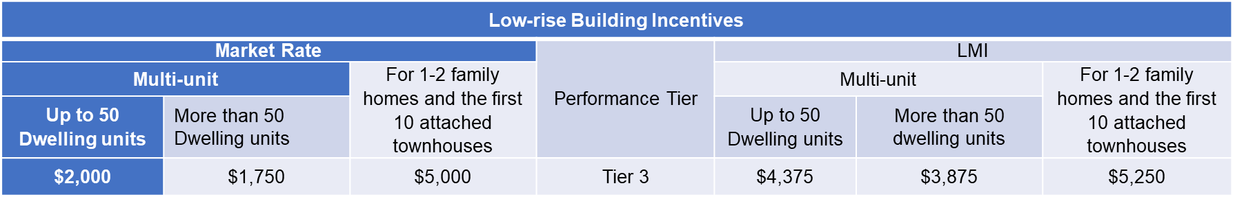
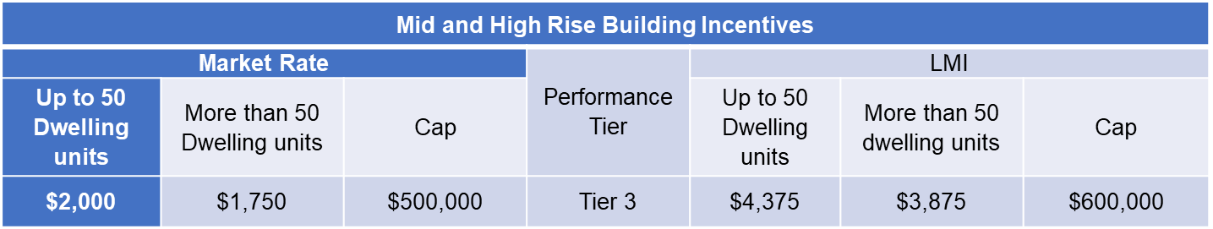
Multifamily New Construction
Technical and Financial Support for Zero Net Energy, Deep Energy Savings, and/or Smart Buildings
Increased incentive levels for projects in the gas constrained areas which achieve ENERGY STAR® Tier 3 performance.

Slide 52
Existing Buildings: Commercial, Industrial, and Multifamily
FlexTech
Financial support for an energy study to identify and evaluate opportunities to reduce energy costs and incorporate clean energy into capital planning. The study can evaluate which building performance systems may be right for your business. (50 – 75% study cost-share); additional support available to help customers in gas constrained areas.
Real Time Energy Management
Financial and technical support for the hardware, software, and consulting services used to gain visibility into the operation of a building's energy systems. Data is gathered in real time for analysis that leads to improved building performance, increased occupant comfort, and greater energy efficiency. (30% cost-share)
On-site Energy Manager
Financial support for a dedicated On-site Energy Manager to inform efficient day-to-day operation and longer-term capital planning of their facility(ies). (75% cost-share)

Slide 53
Existing Buildings: Commercial and Industrial
Strategic Energy Management
100% funded Energy Coach to guide a cohort of facilities (12 maximum) on implementation of a Strategic Energy Management program at the facility. (Currently seeking Industrial customers but will be expanded to Commercial)
REV Campus Challenge
Serves 2 – 4-year public and private universities through technical assistance and other resources – over 125 higher education institutions have joined to date.

Slide 54
Competitive Awards for Large Existing Buildings
Comprehensive Projects Including Gas Efficiency and Electrification
Statewide Efforts (with extra points for gas reduction in constrained area)
Carbon Challenge: launching in May 2020 – due in late Summer 2020
  $15 million in funding available, awards of up to $5 million
  Also planned in 2021
Energy to Lead (Universities and Colleges): due February 20, 2020
  $5 million in funding available, awards of up to $1.5 million

