Slide 1
The Energy Sector and
The New York Climate Leadership and Community Protection Act of 2019
Michael B. Gerrard
Andrew Sabin Professor of Professional Practice
Director, Sabin Center for Climate Change Law

Slide 2
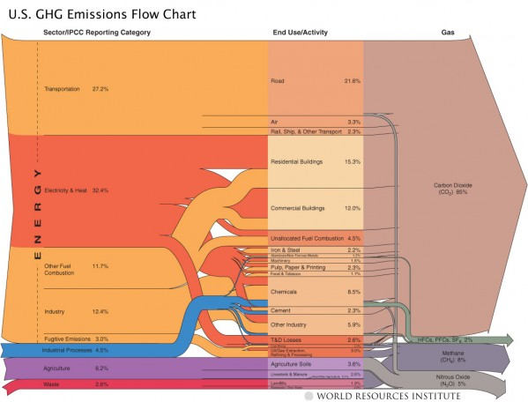

Slide 3
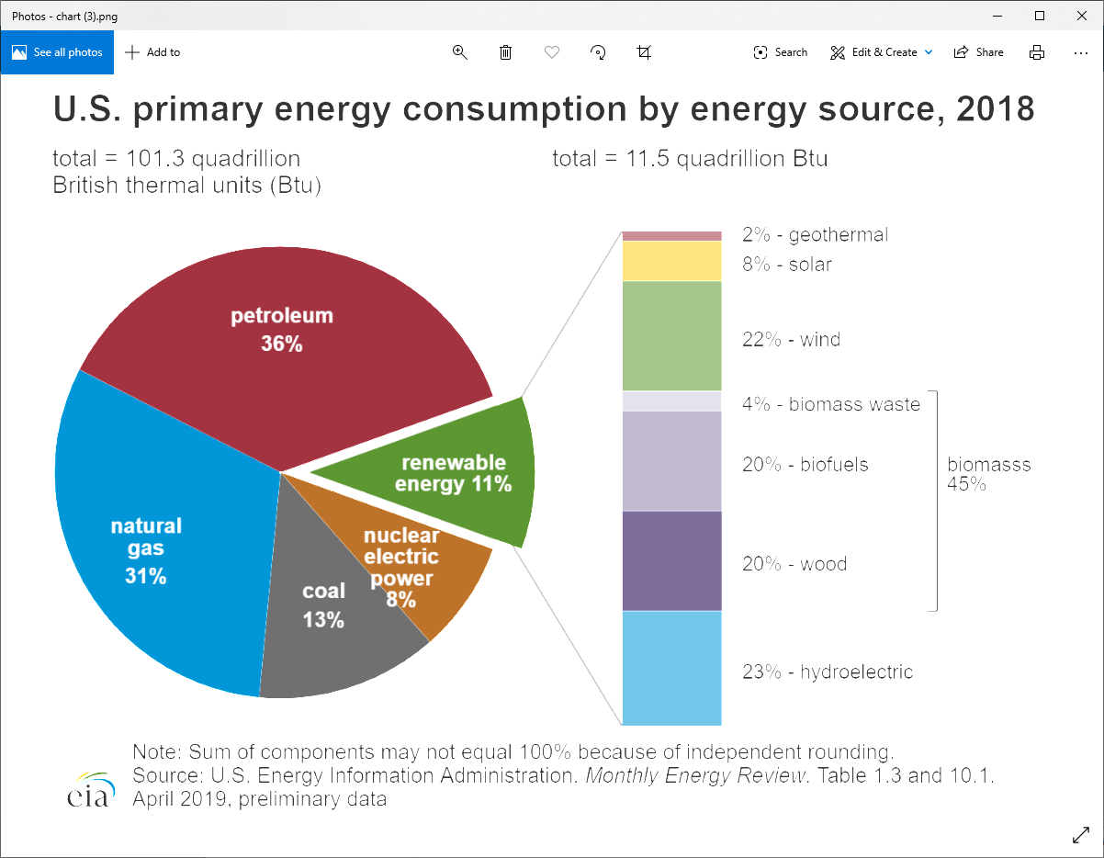

Slide 4
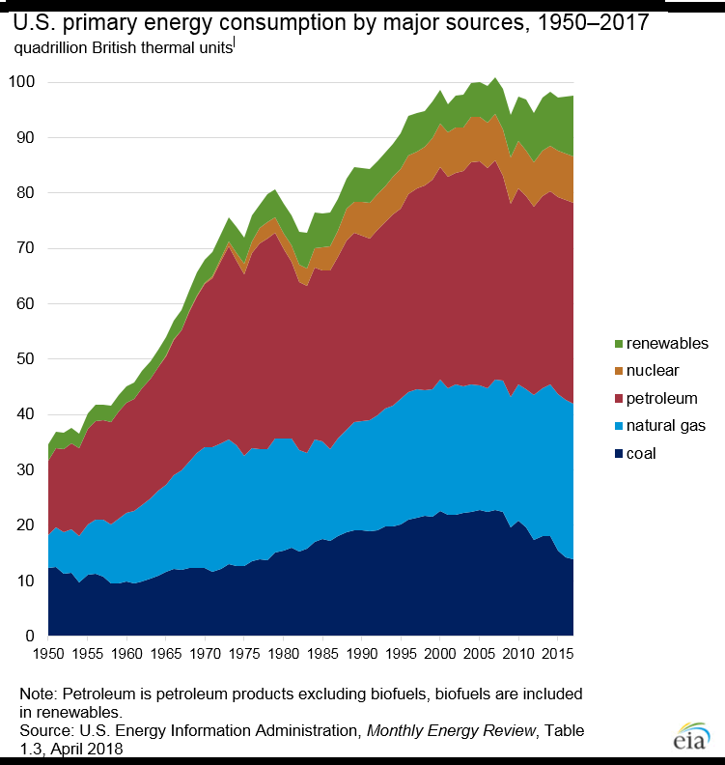

Slide 5
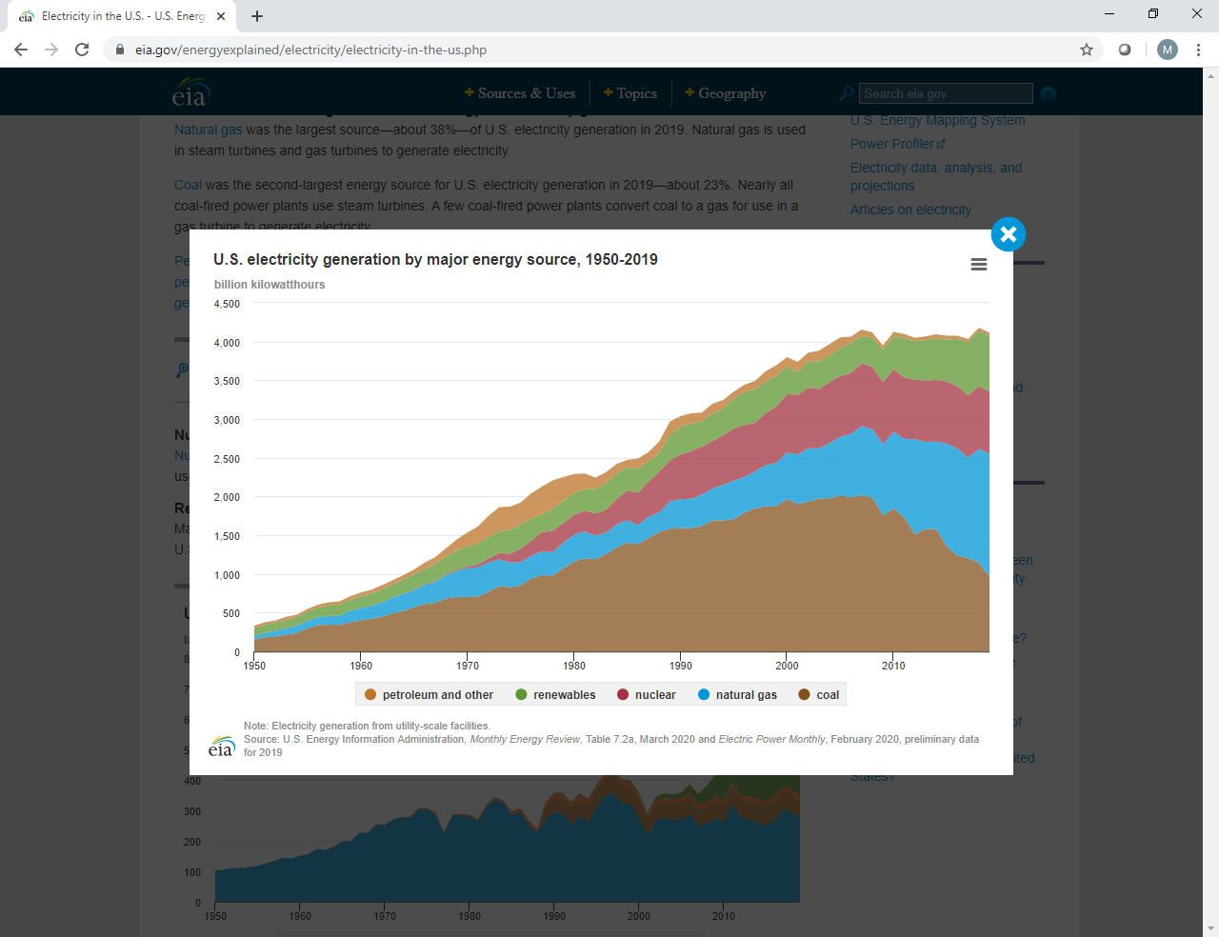

Slide 6
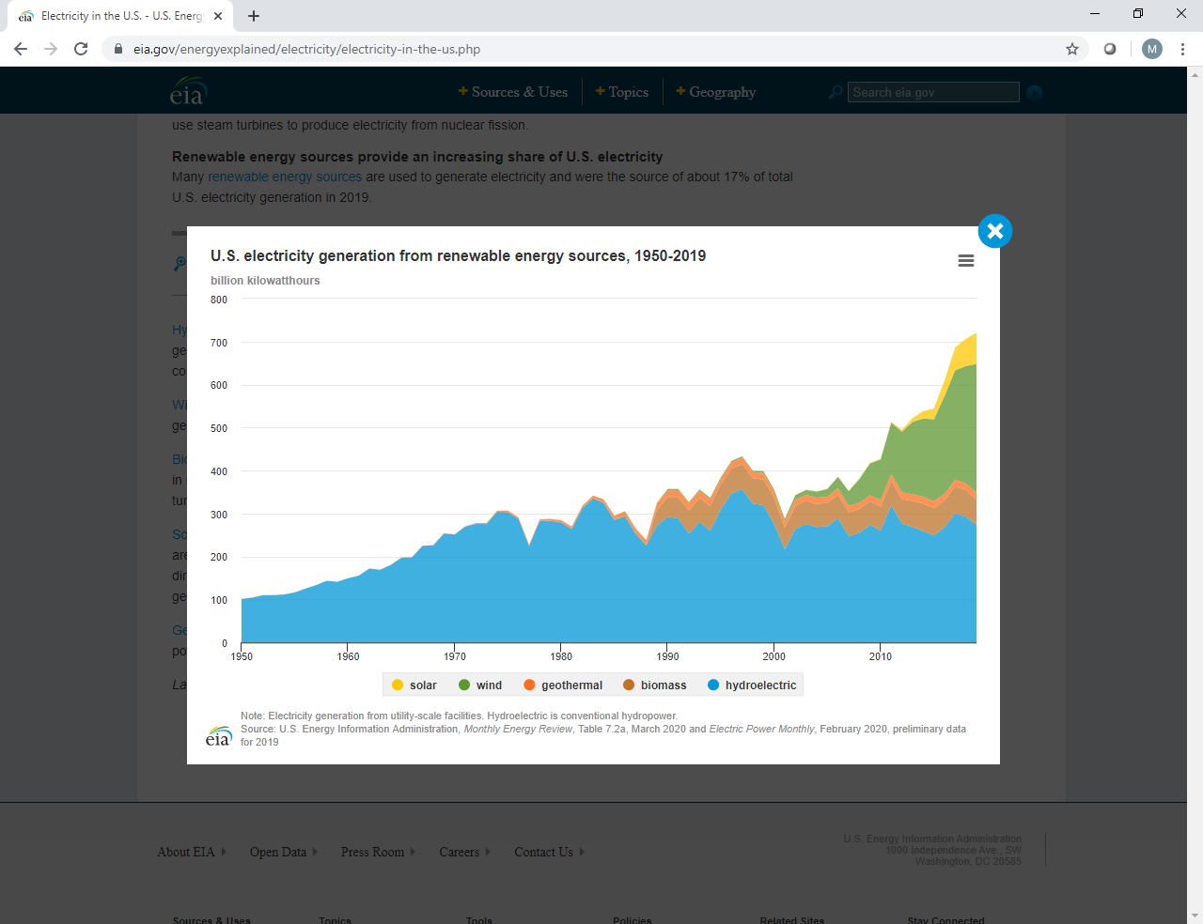

Slide 7
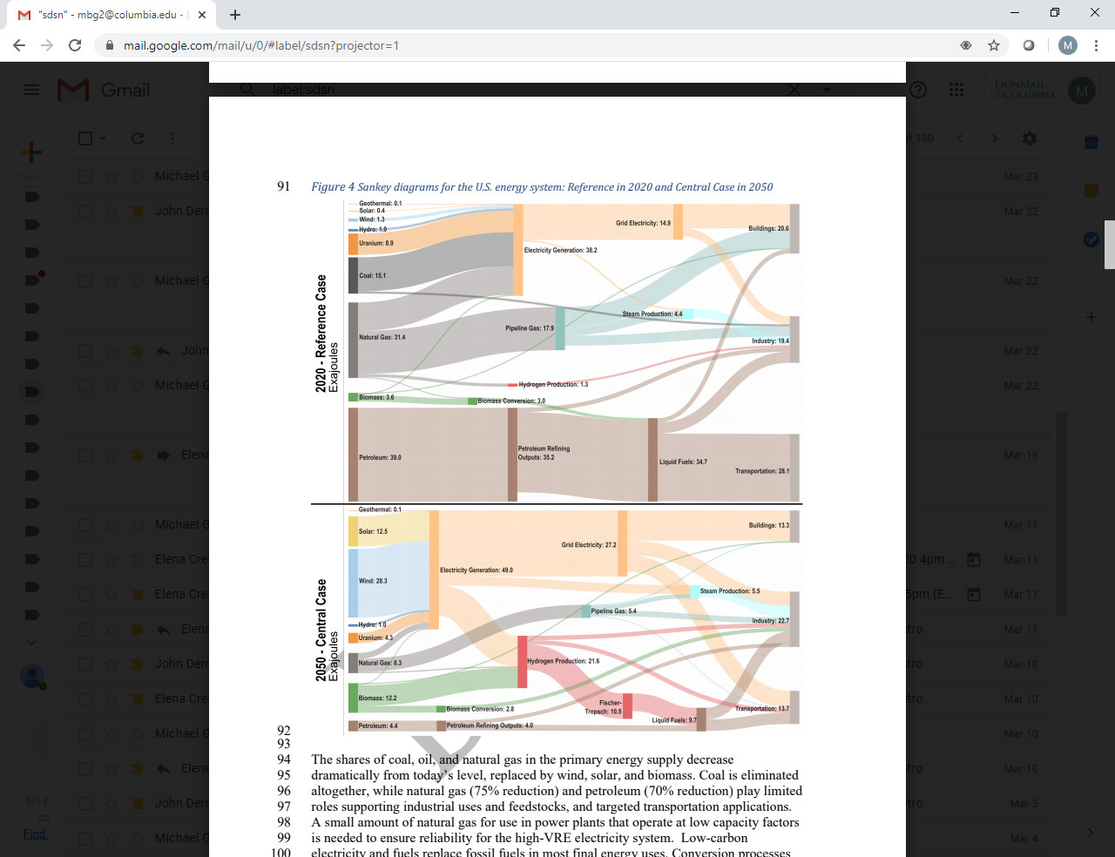

Slide 8
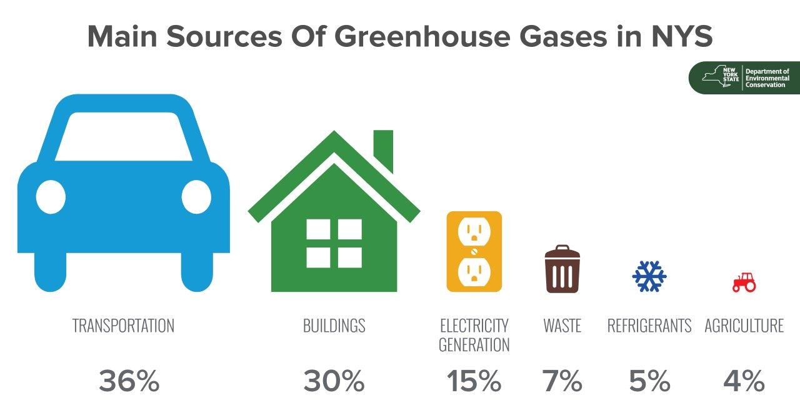

Slide 9
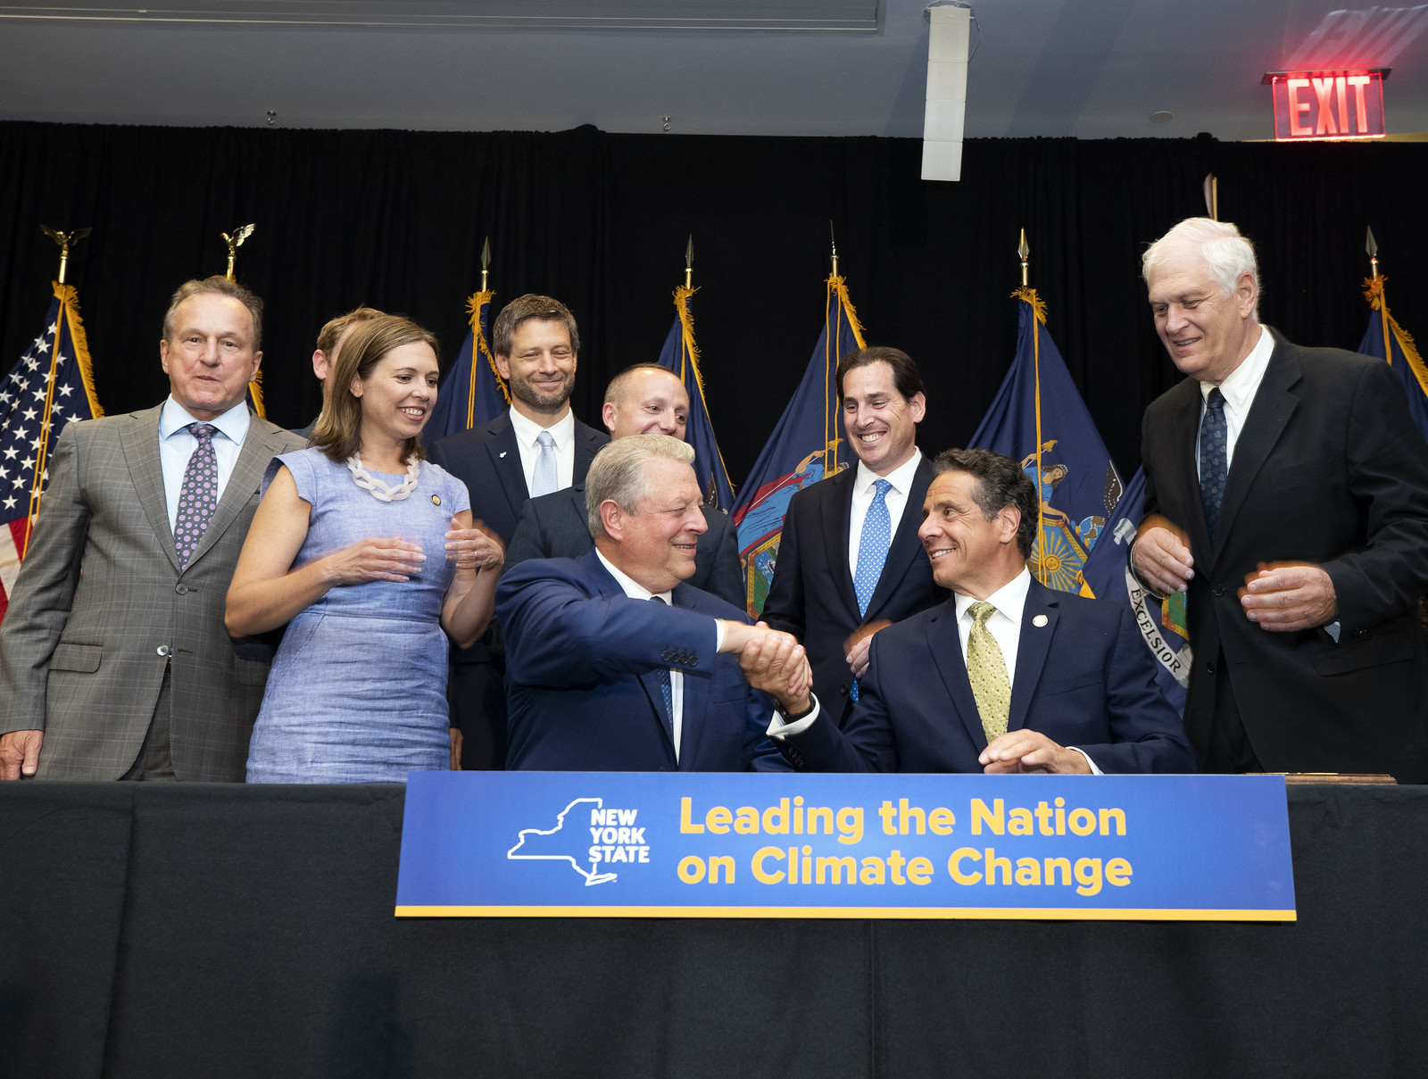

Slide 10
New York Climate Leadership and Community Protection Act of 2019
Reductions below 1990 greenhouse gas emission levels:
2015 8.5%
2030 40%
2050 85% (goal: 100% net)
Electric power demand to be met by:
70% from renewables
100% from “zero emissions”
Minimum requirements:
2025 Efficiency: 185 trillion BTU reduction below 2025 forecast [3,809 trillion BTU]
6 GW distributed solar capacity [now: 1.5 GW]
2030 3 GW energy storage capacity [now: 0.039 GW]
9 GW offshore wind capacity [now: 0]

Slide 11
Sources Meeting New York Electric Demand
2018 (NYISO, Power Trends 2018 p. 23)
39% Fossil
32% Nuclear
23% Hydro
6% Non-hydro renewables
2030 (New law):
70% renewables (2018: 23 + 6 = 29%)
2040 (New law):
100% zero power sector emissions (2018: 32 + 23 + 6 = 61%)

Slide 13
Major Challenges in Meeting Goals
Nuclear will be almost gone
Trump administration weakening of CAFÉ standards
Phaseout of gasoline, diesel vehicles
Retrofit of existing buildings; NYC Local Law 97
Increased electricity demand from electrification of transport, space heating & cooling
Retirement of virtually all natural gas generation
Massive buildout of solar and wind
Workforce
Intermittency of solar and wind
Transmission
Upstate grid already 88% zero emission; downstate, 27%

Slide 14
