Slide 1
Evaluating the Adoption of a Green Amendment to the NYS Constitution
Katrina Fischer Kuh
Haub Distinguished Professor of Environmental Law
October 26, 2021

Slide 2
Section 19, Art. I: Environmental rights. Each person shall have a right to clean air and water, and a healthful environment.
The Green Amendment was passed by the State Senate and Assembly in April 2019.
Senators voted for passage 45 to 17, Assembly members voted for passage 110-34
The Green Amendment was passed by the State Senate and Assembly again in February 2021.
Senators voted 48-14 for second passage, Assembly members voted 124-25 for second passage
To be incorporated into the NYS Constitution, the Green Amendment must be adopted by voters.

Slide 3
Perspective on environmental rights:
~150 countries have environmental right provisions in their constitutions, ~88 of which recognize an express constitutional right to a healthy environment (another dozen recognize a right to a healthy environment as implied by other rights (such as the right to life or dignity))
About 130 nations are subject to regional agreements that recognize a right to a healthy environment, such as the Additional Protocol to the American Declaration of the Rights and Duties of Man
Six state constitutions articulate environmental rights and many more address environmental matters in some fashion, including through the identification of government trust duties
Earlier this month, the Human Rights Council voted to recognize a human right to a healthy environment: "The Human Rights Council…Recognizes the right to a clean, healthy and sustainable environment as a human right that is important for the enjoyment of human rights...."​

Slide 4
Potential value of a Green Amendment
Support robust implementation of environmental statutes (In re Maui Electric Company).
A circuit breaker that can prevent short-term exploitation with long-term environmental and health harm (Robinson Twp. v. Commonwealth).
Prevent irreversible environmental degradation resulting from public choice distortions (MEIC v. DEQ).
Provide citizens with a tool to protect their health and environment when there are statutory/regulatory gaps.

Slide 5
Support robust implementation of environmental statutes
We conclude that, under the circumstances of this case, the protected property interest in a clean and healthful environment asserted by Sierra Club necessitated a hearing by the Commission to consider the impacts of approving the Agreement on Sierra Club's members’ right to a clean and healthful environment, including the release of harmful greenhouse gases by the Pu‘unene Plant that would result from the Agreement, whether the cost of the energy under the Agreement was reasonable in light of the potential for harmful emissions, and whether the terms of the Agreement were prudent in light of the potential hidden and long-term consequences of the Agreement.
-In re Application of Maui Elec. Co., Ltd., 141 Haw. 249, 269 (2017)

Slide 6
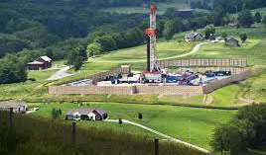
A circuit breaker that can prevent short-term exploitation with long-term environmental and health harm
Robinson Township v. Commonwealth, 623 Pa. 564 (2013)

Slide 7
Prevent irreversible environmental degradation resulting from public choice distortions

Slide 8
Provide citizens with a tool to protect their health and environment when there are statutory/regulatory gaps

Slide 9
“[T]hese gaps are not real gaps, but rather intentional results of a comprehensive process. In other words, according to those questioning the amendment, the current laws are intended to strike a balance that is in the best overall interest of the public….”

Slide 10
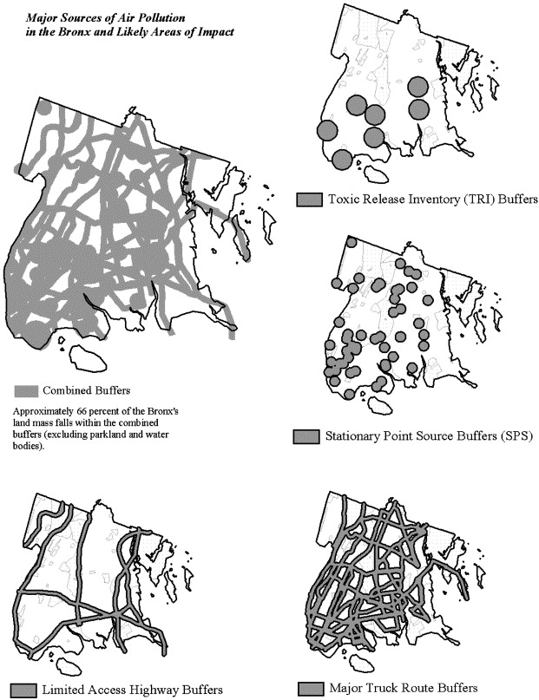
Asthma alley, Bronx

Slide 11
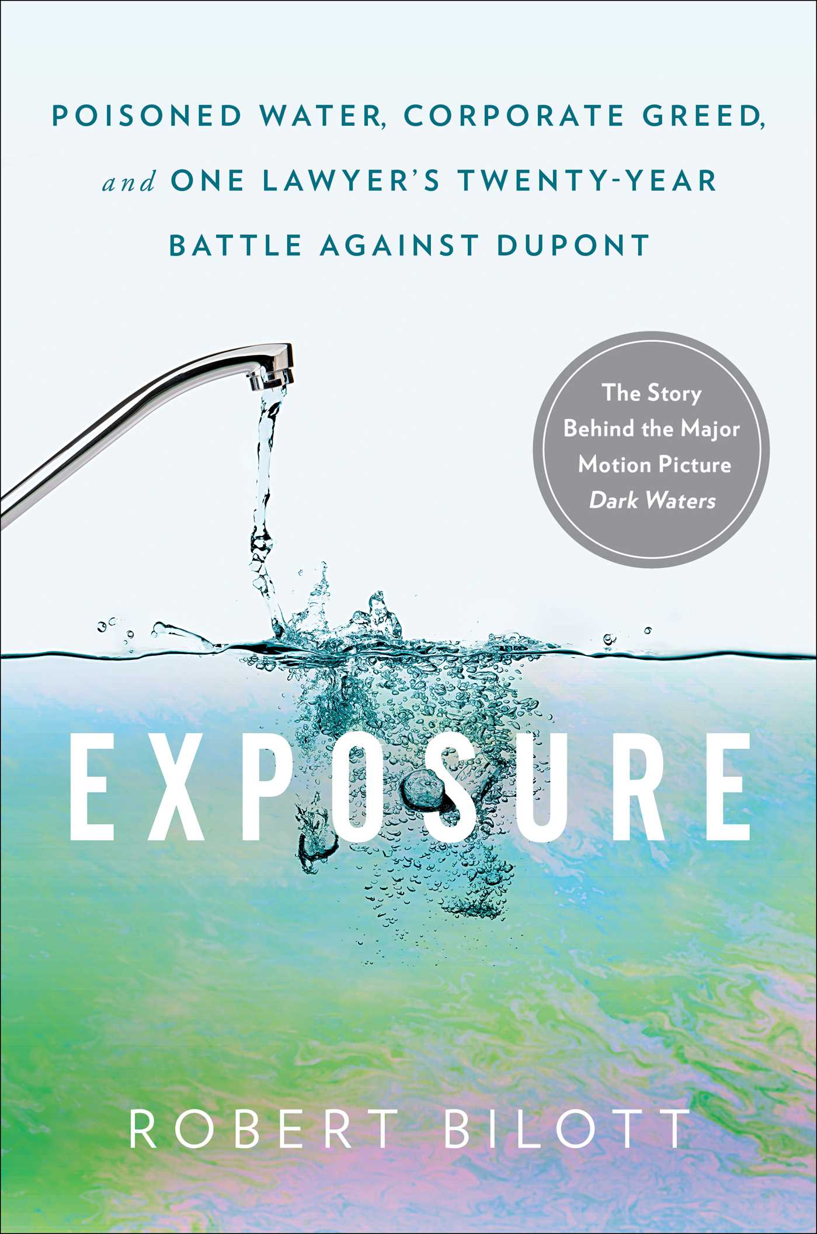
Emerging contaminants
Imagine the counterfactual inquiry—possibilities for a constitutional environmental right to prevent or limit contamination or encourage prompt assessment.

Slide 12
Is the text of NY’s Green Amendment too simple? What is “clean air and water, and a healthful environment”? And doesn’t NY’s constitution already provide for environmental protection?
Comparing proposed NY language to that in other states
Yes but…other constitutional provisions are narrow (Forever Wild) or have been held non-self-executing

Slide 13
PA Const., Art. I, Section 27
The people have a right to clean air, pure water, and to the preservation of the natural, scenic, historic and esthetic values of the environment. Pennsylvania’s public natural resources are the common property of all the people, including generations yet to come. As trustee of these resources, the Commonwealth shall conserve and maintain them for the benefit of all the people.

Slide 14
Mont. Const., Article II, section 3
All persons are born free and have certain inalienable rights. They include the right to a clean and healthful environment . . . .
Article IX, section 1
The state and each person shall maintain and improve a clean and healthful environment in Montana for present and future generations.
(2) The legislature shall provide for the administration and enforcement of this duty.
(3) The legislature shall provide adequate remedies for the protection of the environmental life support system from degradation and provide adequate remedies to prevent unreasonable depletion and degradation of natural resources.

Slide 15
Proposed Green Amendment, NY:
Section 19, Article I: Environmental rights. Each person shall have a right to clean air and water, and a healthful environment.
Which would augment the (non-self-executing) language already in Article IV:
N.Y. State Constitution, Article IV, section 4
The policy of the state shall be to conserve and protect its natural resources and scenic beauty and encourage the development and improvement of its agricultural lands for the production of food and other agricultural products. The legislature, in implementing this policy, shall include adequate provision for the abatement of air and water pollution and of excessive and unnecessary noise, the protection of agricultural lands, wetlands and shorelines, and the development and regulation of water resources.

Slide 16
Article XIV section 4, held not self-executing:
Article 14, section 4 of the New York State Constitution requires the legislature to include adequate provision for the abatement of various types of pollution. It has done so by enacting the ECL. Nothing in the language of this constitutional provision sufficiently restricts the DEC's discretion in enforcing the ECL such that it provides plaintiffs with a source of a constitutionally protected property right. To the contrary, N.Y. Const. art. 125, § 5 provides that “[a] violation of any of the provisions of this article may be restrained at the suit of the people or, with the consent of the supreme court in appellate division, on notice to the attorney-general at the suit of any citizen.” (emphasis added). This permissive language dispels any argument that the DEC, or any other agent of the state, has no discretion whether to enforce Article 14 of the New York State Constitution.
Leland v. Moran, 235 F. Supp. 2d 153, 169 (N.D.N.Y. 2002), aff'd, 80 F. App'x 133 (2d Cir. 2003)

Slide 17
Interpretation and implementation
In interpreting and applying the Green Amendment, courts would be guided by the legislative history accompanying its adoption, a large body of case law in New York re: the adjudication of constitutional rights and environmental statutes, and decisions from other jurisdictions with constitutional environmental rights.
Experience in states with constitutional environmental rights and within New York (with respect to the enforcement of other constitutional rights) speaks to judicial competence to interpret/apply the Green Amendment.
But there are many unknowns about specifically how the Green Amendment would be interpreted and applied.

Slide 18
Will enforcement of an environmental right lead to a lot of expensive litigation?
Other states with robust environmental rights have not experienced large volumes of litigation
Under relevant NY precedent, the right would likely be interpreted not to authorize suits against private parties and not to authorize a damages remedy

Slide 19
From September 2016 through September 2020, the Commonwealth Court issued 13 opinions that produced a holding on section 27 based on Robinson Township or PEDF II. . . .
Citizens or environmental groups brought eight of these cases; industry trade associations brought two; and corporations, homeowners' associations, and cities brought one each.
Five of the cases challenged actions by local governments, and three challenged actions by the Pennsylvania Department of Environmental Protection (DEP). Actions by the Commonwealth, the Public Utility Commission, a company, and a city were challenged in one case each.
John C. Dernbach, Thinking Anew About the Environmental Rights Amendment: An Analysis of Recent Commonwealth Court Decisions, 30 Widener Commonwealth L. Rev. 147, 151 (2020)

Slide 20
Likely not enforceable against private parties
Held enforceable
Held not enforceable
Article I, Section 11
No person shall, because of race, color, creed or religion, be subjected to any discrimination in his or her civil rights by any other person or by any firm, corporation, or institution, or by the state or any agency or subdivision of the state.
Article I, Section 3
The free exercise and enjoyment of religious profession and worship, without discrimination or preference, shall forever be allowed in this state to all humankind….
Article I, Section 8
Every citizen may freely speak, write and publish his or her sentiments on all subjects, being responsible for the abuse of that right; and no law shall be passed to restrain or abridge the liberty of speech or of the press.

Slide 21
Damages remedy? Probably not
Factors considered in evaluating whether a damage remedy is properly implied for a constitutional violation include whether the guaranteed rights “have common-law antecedents warranting a tort remedy for invasion of the rights they recognize” and whether “implying a damage remedy . . . is consistent with the purposes underlying the duties imposed” by the relevant constitutional provisions “and is necessary and appropriate to ensure the full realization of the rights they state.”
Brown v. State, 89 N.Y.2d 172, 233 (1996).

Slide 22
Thank you. Please feel free to contact me with questions at kkuh@law.pace.edu

